Slide 1


Slide 2
Today’s Agenda
Prerequisites?
What is a Angular Js ?
Why Angular Js ?
AngularJS 1 Vs Angularjs 2
AngularJS Editors & Environments ?

Slide 3
Prerequisites?
Understanding of Web Technologies
HTML/HTML5
CSS/CSS3/BOOTSTRAP
JAVA SCRIPT
JSON
AngularJS 1

Slide 4
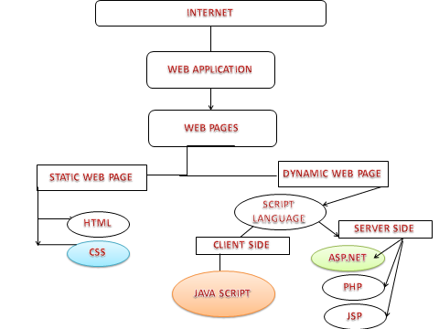
Understanding Web Technologies

Slide 5
Getting To Know The AngularJS Framework
AngularJS is an open-source JavaScript framework, maintained by Google, that assists with running single-page applications
AngularJS allows the developer to specify custom and reusable HTML tags that moderate the behavior of certain elements these attributes are called ‘Diretives’. Example: ng-app , ng-model etc.
AngularJS is a JavaScript framework. It is a library written in JavaScript.
AngularJS is quickly becoming the dominant JavaScript framework for professional web development.

Slide 6

Why AngularJS?
Get Started in Minutes & less Coding
Notes:
Developers do not need to write their own pipeline.
As for the view, it is defined using HTML to make it more concise.
Data model is simple, as you do not need the getter/setter functions.
The data-binding feature allows developers to stop providing data manually into the view.
As directives are separate from app code, other teams can write it without any integration issue.
Filters allow you to manipulate the data on the view level without changing your controllers.
Less coding, helps developers to keep a track of the functions in a systematic manner.

Slide 7
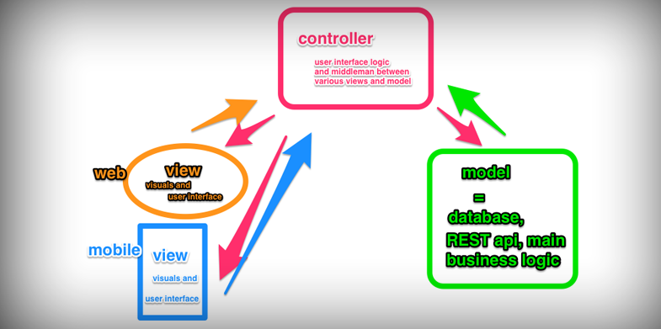
Why AngularJS?
MVC done right
Notes:
Most frameworks implement MVC by asking you to split your app into MVC components, then require you to write code to string them up together again. That’s a lot of work. Angular implements MVC by asking you to split your app into MVC components, then just let Angular do the rest. Angular manages your components for you and also serves as the pipeline that connects them.

Slide 8

Why AngularJS?
Data models are POJO
Notes:
Data models in Angular are plain old JavaScript objects (POJO) and don’t require extraneous getter and setter functions. You can add and change properties directly on it and loop over objects and arrays at will. Your code will look much cleaner and more intuitive, the way mother nature intended.

Slide 9
Two-way Data Binding
One way data binding
Two way data binding
VIEW
TEMPLATE
Change in model
Updates view
Change in view
Updates model
One-time
Merge
VIEW
CONTINUOUS UPDATE
TEMPLATE
Model
Model

Slide 10
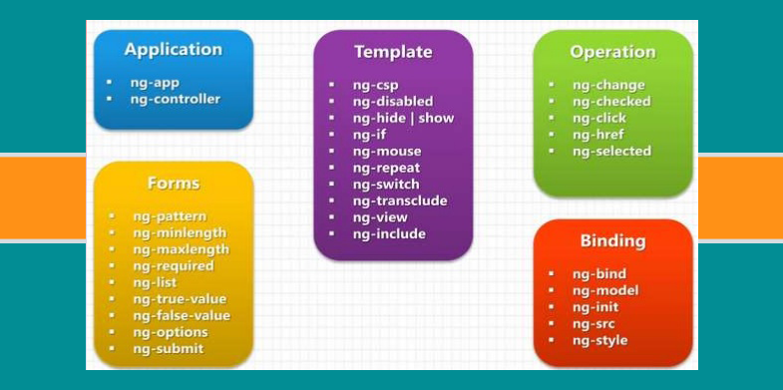
Why AngularJS?
Behavior with directives
Notes:
Directives achieve this by enabling us to invent our own HTML elements. By putting all our DOM manipulation code into directives, we can separate them out of our MVC app. This allows our MVC app to only concern itself with updating the view with new data. How the view subsequently behaves is up to the directives.
Directives come in the form of custom HTML elements
<myticker></myticker>
custom attributes
<div data-myticker></div>
and custom class names
<div class="myticker"></div>

Slide 11
Angular JS: Directives
I am ng-model and i am a directive.
<input ng-model=“hell">
Directives are markers on a DOM element (such as an attribute, element name, or CSS class) that tell AngularJS's HTML compiler ($compile) to attach a specified behavior to that DOM element or even transform the DOM element and its children.
Angular provide some in-built directives like ngApp(ng-app), ngModel(ng-model), ngIf(ng-if) etc.

Slide 12
Why AngularJS?
Flexibility with filters
Filters filter the data before they reach the view and can involve something as simple as formatting decimal places on a number, reversing the order of an array, filtering an array based on a parameter, or implementing pagination. Filters are designed to be standalone functions that are separate from your app, similar to Directives, but are only concerned with data transformations.
Filters are so resourceful that it is possible to create a sortable HTML table using only filters without writing any JavaScript.

Slide 13
Angular JS: Filters
I am a Filter. I will show up to 2 decimal points only i.e. 1.23
{{ 1.234 | number:2 }}
A filter formats the value of an expression for display to the user.
They can be used in view templates, controllers or services and it is easy to define your own filter.
{{ expression | filter }}
{{ expression | filter1 | filter2 | ... }}
{{ expression | filter:arg1 : arg2 ... }}

Slide 14
Why AngularJS?
Unit testing ready
What description of Angular would be complete without talking about it’s unit testing readiness? The whole of Angular is linked together by Dependency Injection (DI). It’s what it uses to manage your controllers and scopes. Because all your controllers depend on DI to pass it information, Angular’s unit tests are able to usurp DI to perform unit testing by injecting mock data into your controller and measuring the output and behavior. In fact, Angular already has a mock HTTP provider to inject fake server responses into controllers.

Slide 15
What Is New And Different About AngularJS
AngularJS has become one of the most popular open source JavaScript frameworks in the world of web application development. Since its inception, it has witnessed phenomenal growth in terms of adoption and community support—both from individual developers and corporations.
From humble beginnings, Angular has matured into a client-side MVW framework (that’s Model-View-Whatever) for the building of complex single-page applications. It places equal importance on application testing and application writing, while simplifying the development process.

Slide 16
Important Download - Working Files
Including angular scripts from the Google CDN
The quickest way to get started is to point your html <script> tag to a Google CDN URL. This way, you don't have to download anything or maintain a local copy.
There are two types of angular script URLs you can point to, one for development and one for production:
angular.js — This is the human-readable, non-minified version, suitable for web development.
angular.min.js — This is the minified version, which we strongly suggest you use in production.

Slide 17
To point your code to an angular script on the Google CDN server
<!doctype html>
<html ng-app>
<head>
<title>My Angular App</title>
<script src="https://ajax.googleapis.com/ajax/libs/angularjs/1.4.5/angular.min.js">
</script>
</head>
<body>
</body>
</html>

Slide 18
ANGULARJS 1.X Basic Program Structure
<!DOCTYPE html>
<html>
<script src= "http://ajax.googleapis.com/ajax/libs/angularjs/1.3.14/angular.min.js"></script>
<body>
<div ng-app="">
<p>Input something in the input box:</p>
<p>Name : <input type="text" ng-model="name" placeholder="Enter name here"></p>
<h1>Hello {{name}}</h1>
</div>
</body>
</html>

Slide 19


Slide 20
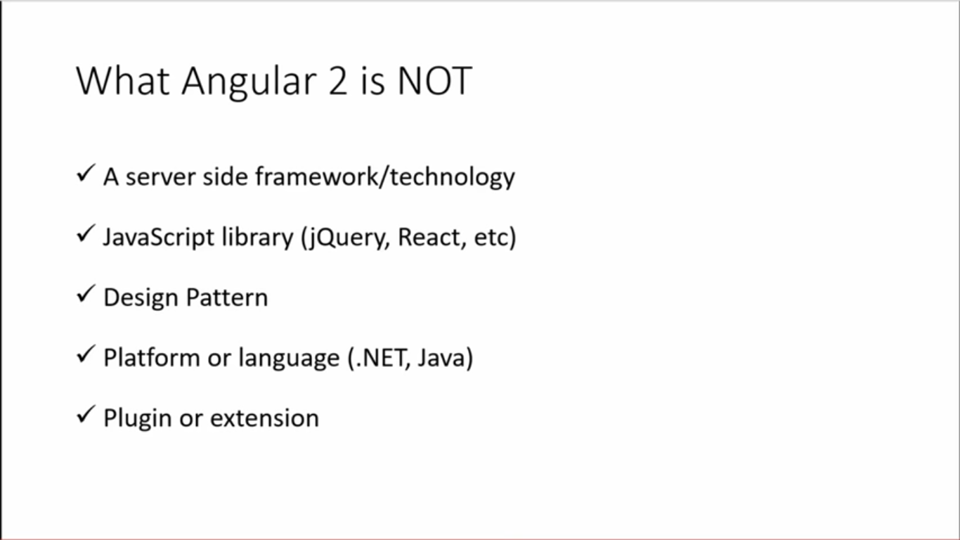

Slide 21
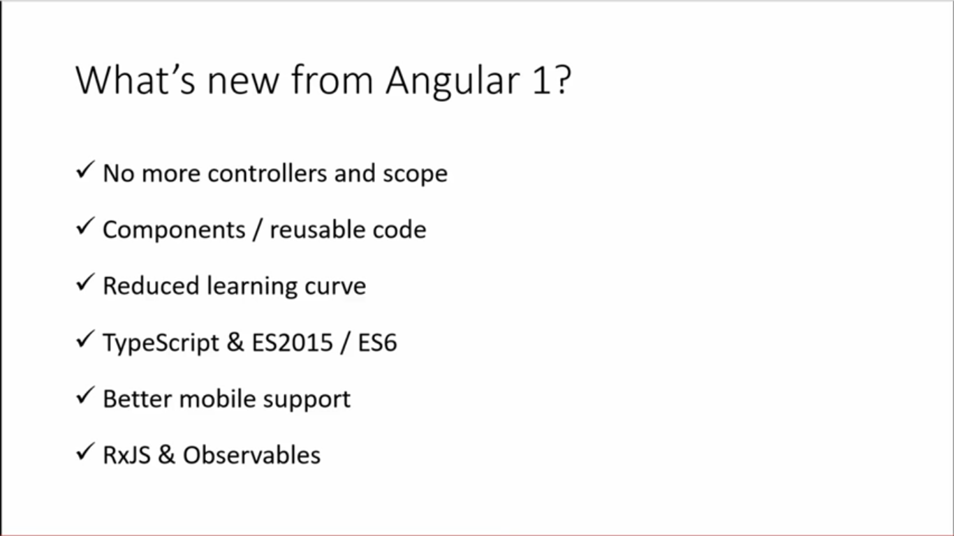

Slide 22
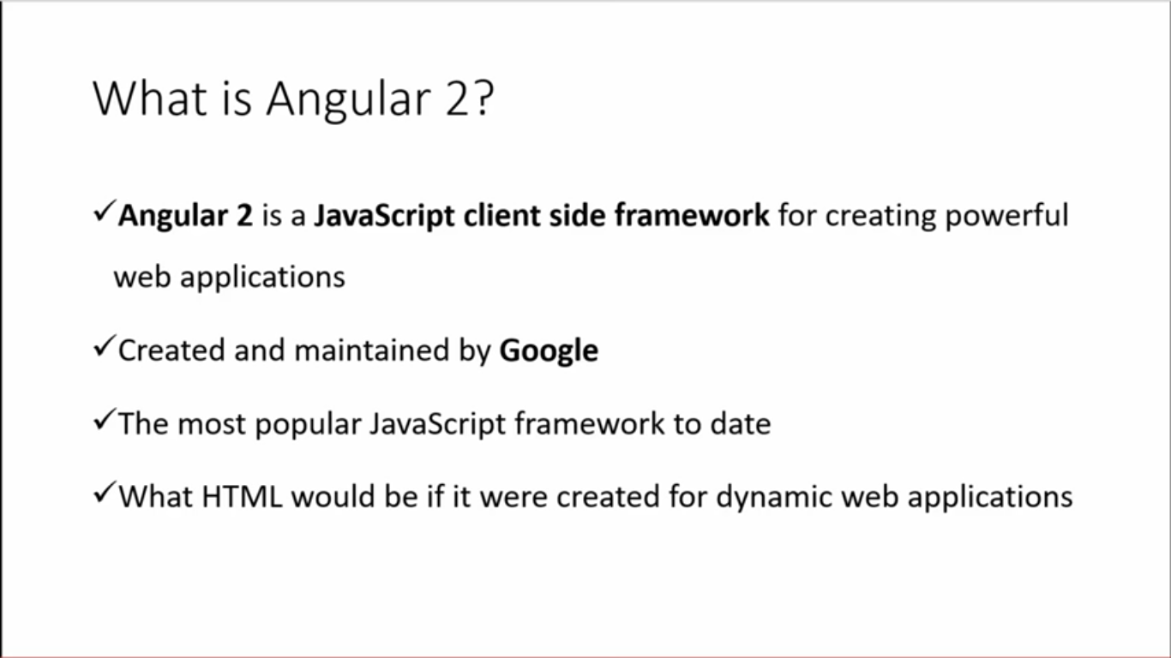

Slide 23
ANGULAR 2: IMPORTANT POINTS
One framework. Mobile & desktop.
Develop Across All Platforms
Learn one way to build applications with Angular and reuse your code and abilities to build apps for any deployment target. For web, mobile web, native mobile and native desktop.

Slide 24
ANGULAR 2: IMPORTANT POINTS
Speed & Performance
Achieve the maximum speed possible on the Web Platform today, and take it further, via Web Workers and server-side rendering.
Angular puts you in control over scalability. Meet huge data requirements by building data models.

Slide 25
ANGULAR 2: IMPORTANT POINTS
Incredible Tooling
Build features quickly with simple, declarative templates. Extend the template language with your own components and use a wide array of existing components. Get immediate Angular-specific help and feedback with nearly every IDE and editor. All this comes together so you can focus on building amazing apps rather than trying to make the code work.

Slide 26
ANGULAR 2: IMPORTANT POINTS
Loved by Millions
From prototype through global deployment, Angular delivers the productivity and scalable infrastructure that supports Google's largest applications.

Slide 27
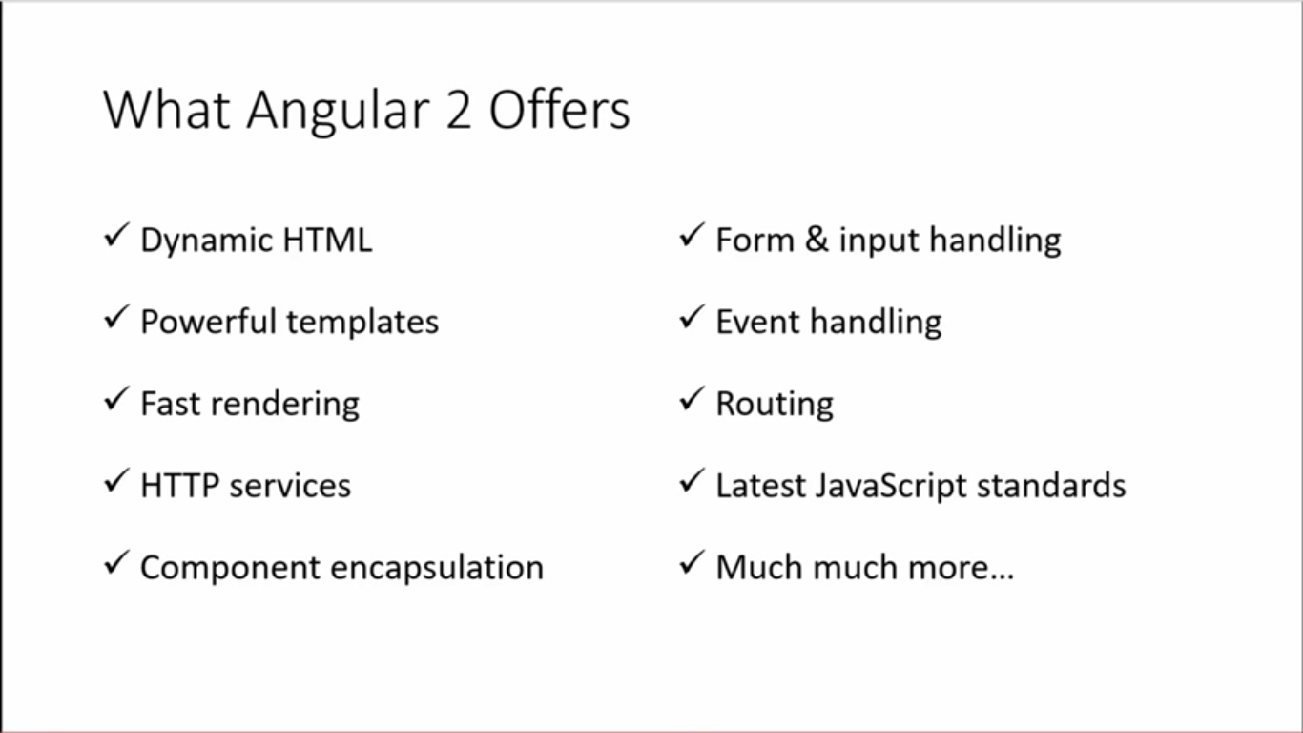

Slide 28
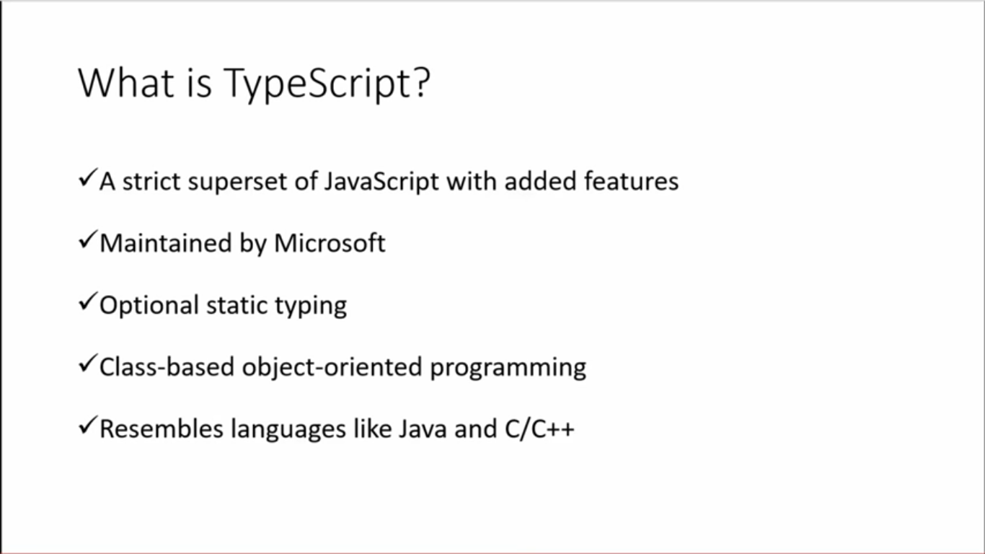

Slide 29
What is TypeScipt
Open source language.
Superset of JavaScript.
Transpiles to plain JavaScript.
Strongly typed.
.ts Extension.
Class-Based object orientation.

Slide 30
TypeScript Editors
Visual Studio.
Visual Studio Code.
Atom.
Eclipse.
Others.

Slide 31

ANGULAR SETUP ENVIRONMENT

Slide 32
Option to Start Angular
Use Official Website www.angular.io
Quick Start
AngularCli
Manually perform each step

Slide 33
QUICK START
The QuickStart live-coding / download example example is an Angular playground..
Setting up a new project on your machine is quick and easy with the QuickStart seed, maintained on github.
Make sure you have node and npm installed.

Slide 34
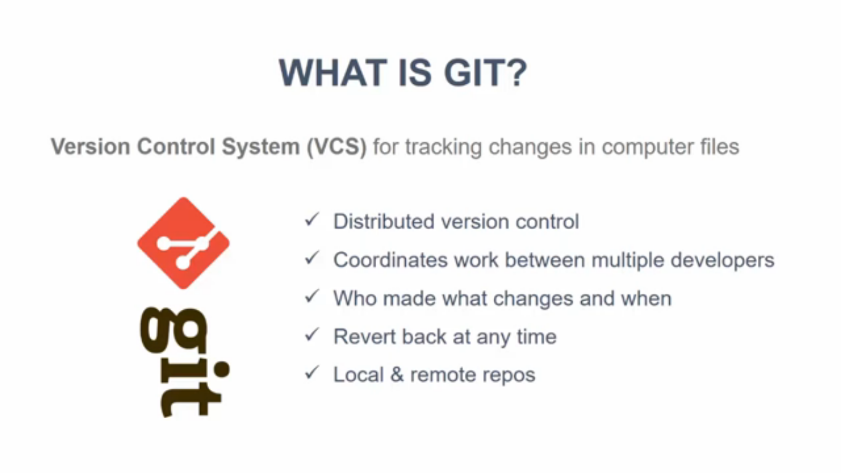

Slide 35
QUICK START
Clone
Perform the clone-to-launch steps with these terminal commands
https://git-scm.com/ (git official website)
git clone https://github.com/angular/quickstart.git quickstart
cd quickstart
npm install
npm start

Slide 36
QUICK START
Download
Download the QuickStart seed and unzip it into your
project folder. Then perform the remaining steps with
these terminal commands.
cd quickstart
npm install
npm start

Slide 37
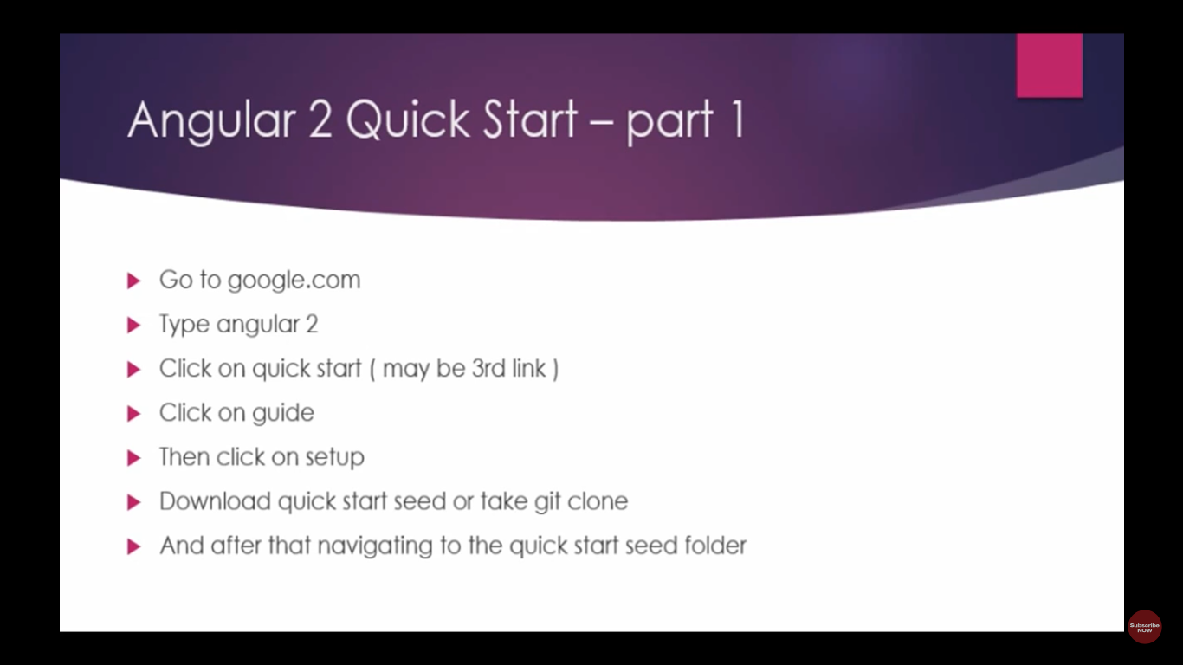

Slide 38
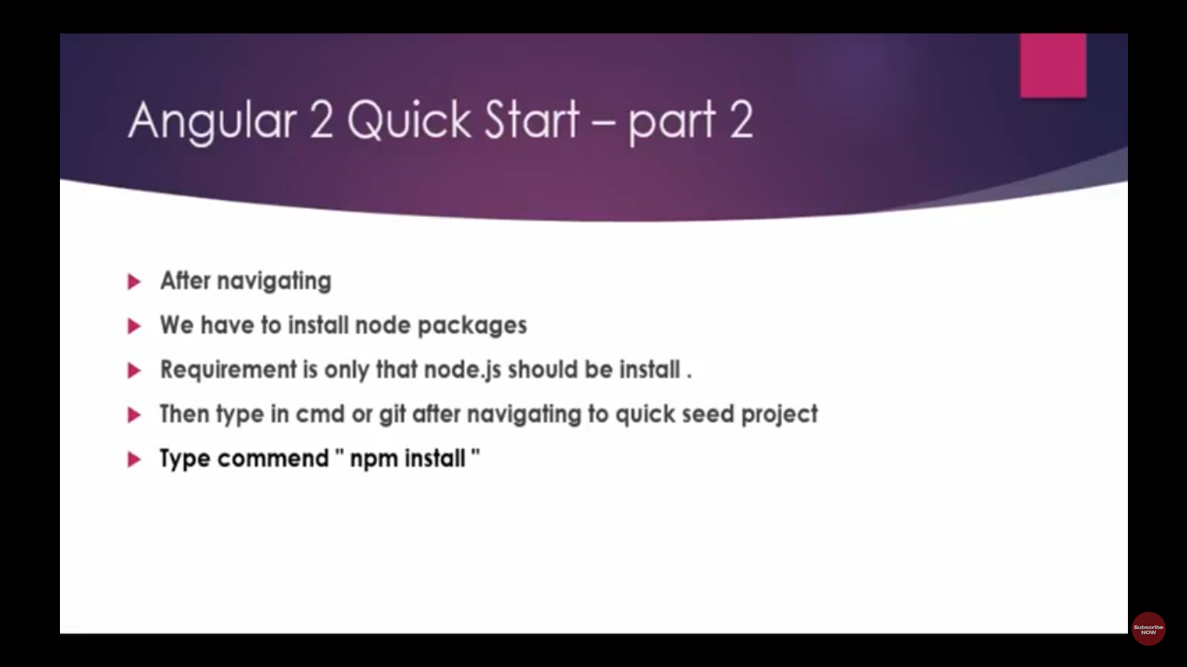

Slide 39
Setup a environment Using Quick Start
1. Download quick start https://angular.io/guide/quickstart or from github
2. Extract zip and Rename folder name to myproject
3. Put this folder on c drive and change folder cd myproject
4. Download nodejs https://nodejs.org/en/download/
5. Install Nodejs
6. go to the command Prompt(cmd)
7. Check Nodejs is install or not
c:/myproject> node –v
8. install node package manager(npm) inbuilt part of nodejs (Install all packages required for the angular2)
c:/myproject>npm install –g (global)
c:/myproject> npm –v (check npm install or not)
9. Start Project
c:/myproject>npm start

Slide 40
Setup a environment Using Angular Command Line interface(cli)
1. Download nodejs https://nodejs.org/en/download/
2. Install Nodejs
3. go to the command Prompt(cmd)
4. Check Nodejs is install or not
c:/myproject> node –v
5. install node package manager(npm) inbuilt part of nodejs (Install all packages required for the angular2) with cli
c:/myproject>npm install –g @angular/cli
c:/myproject> npm –v (check npm install or not)
6. c:/myproject> ng new web-app
7. c:/myproject> cd web-app
8. Start Project
c:/myproject/web_app>ng serve - - open (same as npm start)

Slide 41

Setup a environment Using Angular Command Line interface(cli)
The ng serve command launches the server, watches your files, and rebuilds the app as you make changes to those files.
Using the --open (or just -o) option will automatically open your browser on http://localhost:4200/.
Your app greets you with a message:

Slide 42
Command Line interface(cli)
Prerequisites
Both the CLI and generated project have dependencies that require Node 4 or higher, together with NPM 3 or higher.

Slide 43
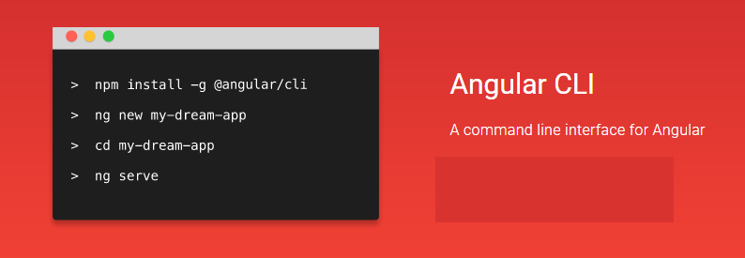
Command Line interface(cli)

Slide 44
Command Line interface(cli)
Installation
Usage
Generating a New Project
Generating Components, Directives, Pipes and Services
Generating a Route
Creating a Build
Build Targets and Environment Files
Base tag handling in index.html
Bundling
Running Unit Tests
Running End-to-End Tests
Proxy To Backend

Slide 45
Command Line interface(cli)
Deploying the App via GitHub Pages
Linting code
Commands autocompletion
Project assets
Global styles
CSS preprocessor integration
3rd Party Library Installation
Global Library Installation
Updating angular-cli
Development Hints for hacking on angular-cli

Slide 46
ANGULAR CLI
ng new
The Angular CLI makes it easy to create an application that already works, right out of the box. It already follows our best practices!
ng generate
Generate components, routes, services and pipes with a simple command. The CLI will also create simple test shells for all of these.
ng serve
Easily test your app locally while developing.

Slide 47
Command Line interface(cli) : Installation
npm install -g angular-cli
Usage
ng help
Generating and serving an Angular2 project via a development server
ng new PROJECT_NAME
cd PROJECT_NAME
ng serve
Navigate to http://localhost:4200/. The app will automatically reload if you change any of the source files.
You can configure the default HTTP port and the one used by the LiveReload server with two command-line options :
ng serve --host 0.0.0.0 --port 4201 --live-reload-port 49153

Slide 48
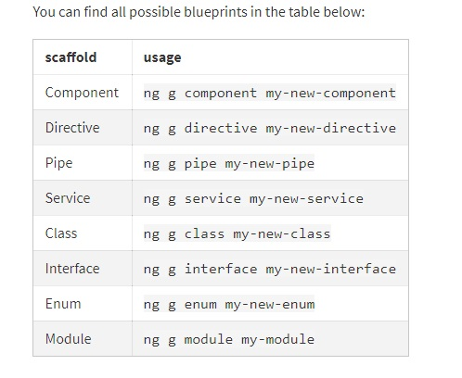
Command Line interface(CLI)

Slide 49
Setting Up Environment Manually
Npm – Node Package Manager
Set up the Angular 2 application.
1. Create an application folder.
2. Create the tsconfig.json file.
3. Create the package.json file.
4. Create the typings.json file.
5. Install the libraries and typings.
6. Create the host Web Page(index.html)
7. Create the main.ts file(bootstrapper)

Slide 50
HOW ANGULAR WORKS :
Step 1: First of all we will install Node.js and NPM in our OS. Step 2: will run npm install using command prompt navigating to root directory of the project. It will create node_modules folder parallel to package.json.
Step 3: npm install command will download all the required libraries and then run npm start command that will compile all the TS files into JS files and will continue to observe for any change in our files in development mode and response will display on the browser.

Slide 51
What is npm?
npm is the package manager for JavaScript. It's also the world's largest software registry. There are over 600,000 packages of JavaScript code available to download, with approximately 3 billion downolads per week. npm makes it easy for JavaScript developers to reuse code other developers have shared.

Slide 52
NPM-The Node Package Manager?
Node.js makes it possible to write applications in JavaScript on the server. It’s built on the V8 JavaScript runtime and written in C++ — so it’s fast. Originally, it was intended as a server environment for applications, but developers started using it to create tools to aid them in local task automation.

Slide 53
NPM-The Node Package Manager?
To make use of tools (or packages) in Node.js we need to be able to install and manage them in a useful way. This is where npm, the Node package manager, comes in. It installs the packages you want to use and provides a useful interface to work with them.

Slide 54
NPM-The Node Package Manager?
Let’s see where node was installed and check the version.
$ which node
/usr/bin/node
$ node --version
v6.10.3
To verify that your installation was successful let’s give Node’s REPL a try.
$ node
> console.log('Node is running');
Node is running

Slide 55
NPM-The Node Package Manager?
npm can install packages in local or global mode. In local mode it installs the package in a node_modules folder in your parent working directory. This location is owned by the current user. Global packages are installed in {prefix}/lib/node_modules/which is owned by root (where {prefix} is usually /usr/ or /usr/local).

Slide 56
NPM-The Node Package Manager?
Uninstall global package.
1 2 3 | $ npm uninstall <package name> -g # example $ npm uninstall express -g
Uninstall local package.
$ cd /path/to/the/project
$ npm uninstall <package name>
# example
$ npm uninstall express

Slide 57
NPM-The Node Package Manager?
List global packages.
npm ls –g
List Global Package details:
npm ls –gl
List local packages.
Cd/path/to/the/project
Npm ls npm ls –l (in detail)

Slide 58
NPM-The Node Package Manager?
Update global packages.
$ npm update –g
Update local packages.
Cd/path/to/the/project
$npm update

Slide 59
Angular 2 using TypeScript Step by Step
TypeScript is a strict superset of JavaScript. It supports static typing and class based object oriented programming. We write code into TypeScript that will finally be compiled into JavaScript to run in browser.

Slide 60
FOLDER STRUCTURE
The src folder
Your app lives in the src folder. All Angular components, templates, styles, images, and anything else your app needs go here. Any files outside
of this folder are meant to support building your app.

Slide 61
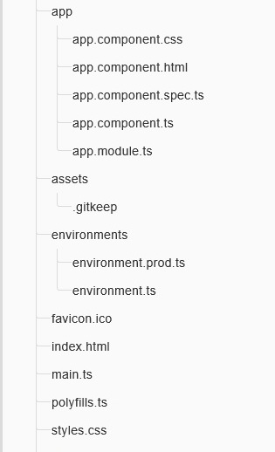
FOLDER STRUCTURE

Slide 62
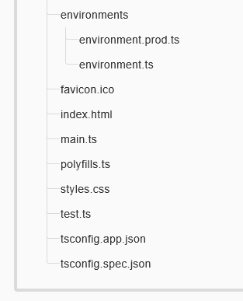
FOLDER STRUCTURE

Slide 63
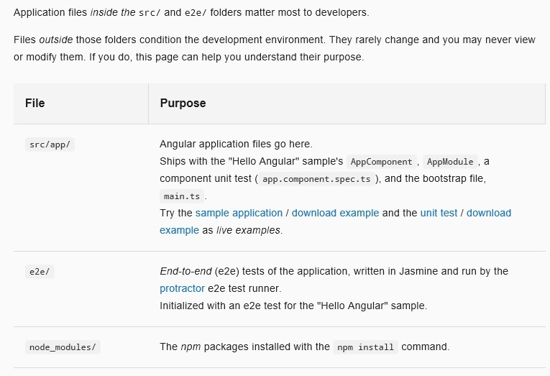
FOLDER STRUCTURE

Slide 64
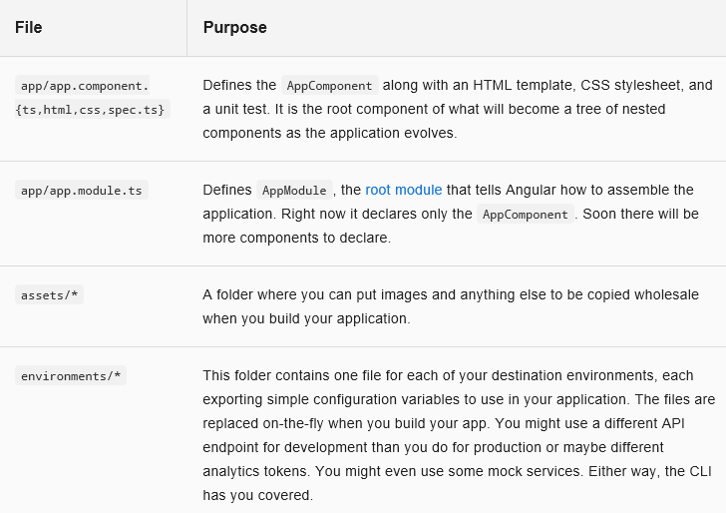
FOLDER STRUCTURE

Slide 65
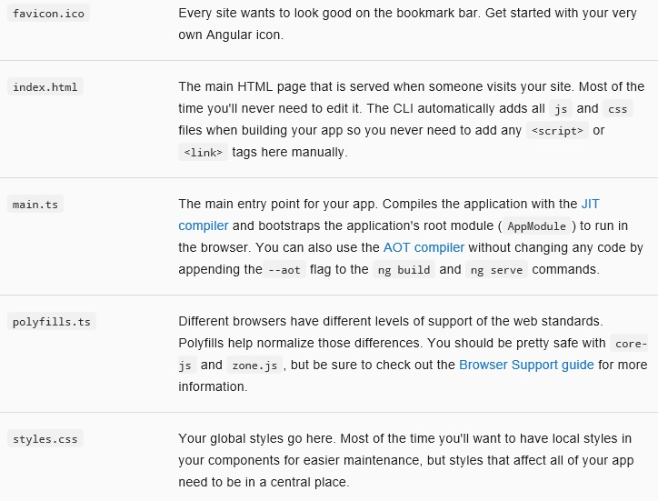
FOLDER STRUCTURE

Slide 66
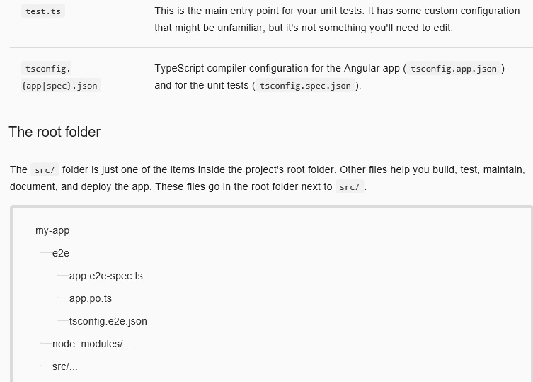
FOLDER STRUCTURE

Slide 67
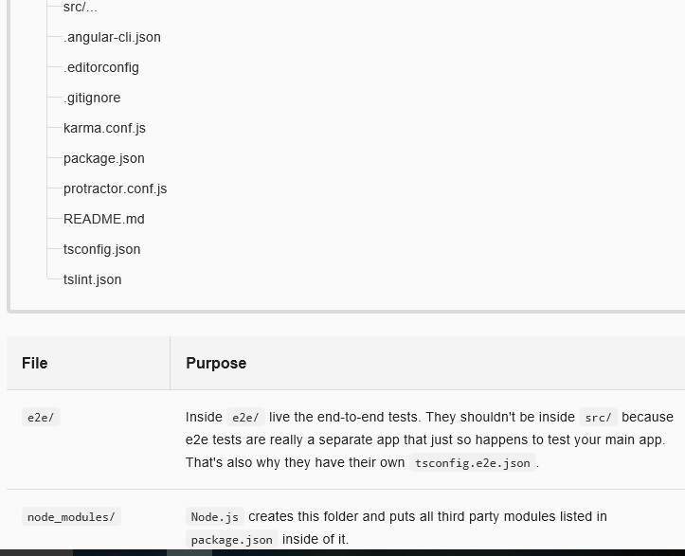
FOLDER STRUCTURE

Slide 68
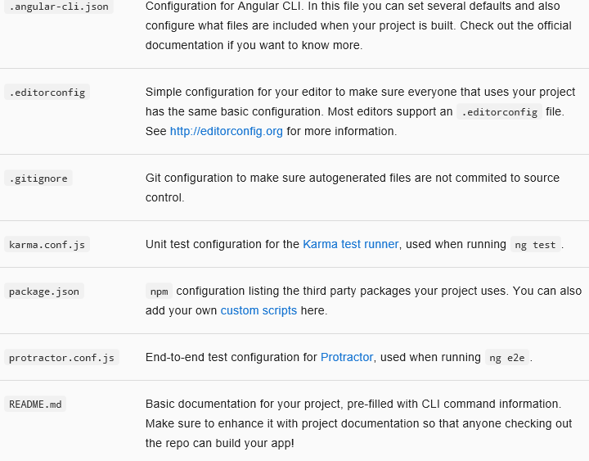
FOLDER STRUCTURE

Slide 69
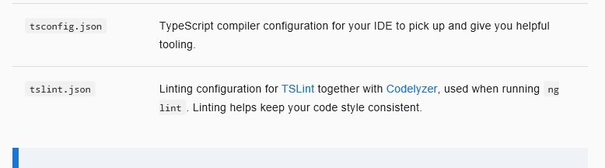
FOLDER STRUCTURE

Slide 70
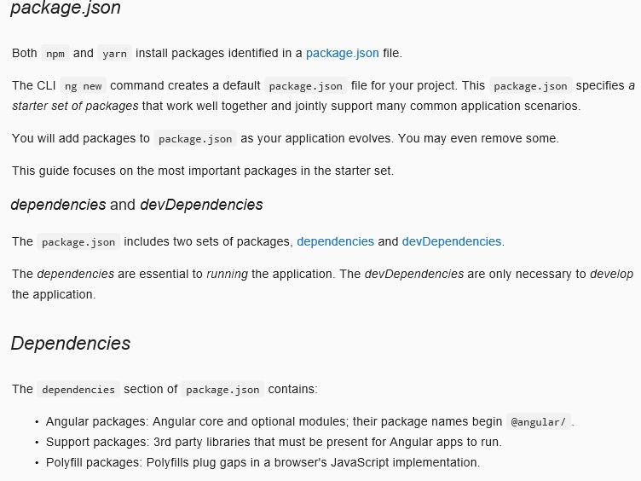
FOLDER STRUCTURE

Slide 71
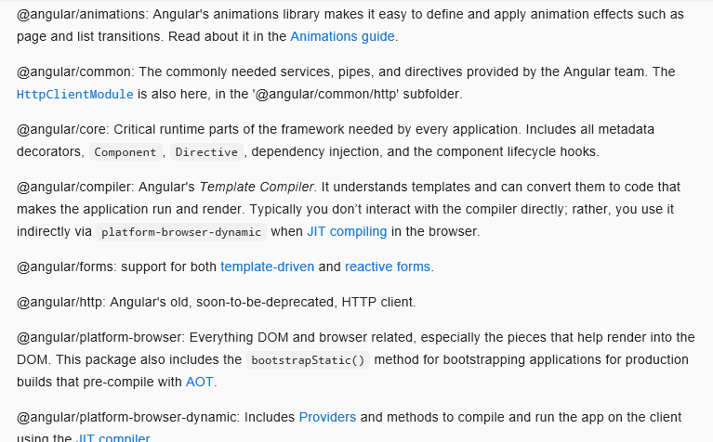
FOLDER STRUCTURE: ANGULAR PACKAGE

Slide 72
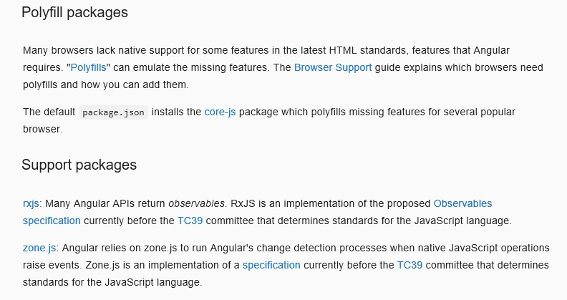
ANGULAR PACKAGE

Slide 73
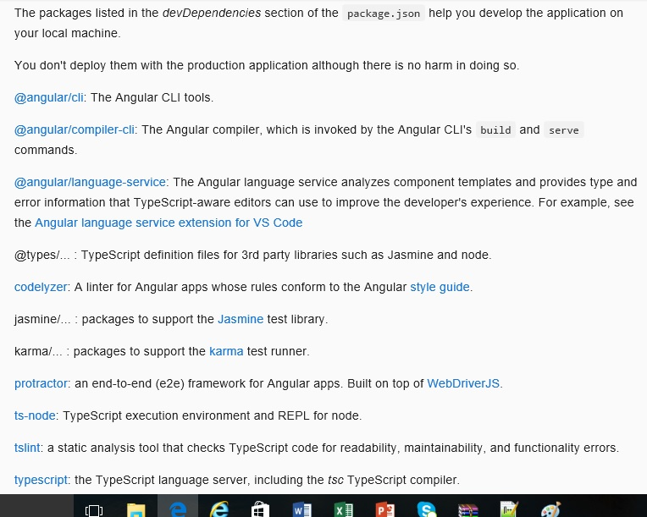
ANGULAR DEPENDENCIES

Slide 74
package.json
package.json specifies a starter set of packages that work well together and jointly support many common application scenarios.
You will add packages to package.json as your application evolves. You may even remove some.

Slide 75
tsconfig.json
The presence of a tsconfig.json file in a directory indicates that the directory is the root of a TypeScript project. The tsconfig.json file specifies the root files and the compiler options required to compile the project.

Slide 76
tsconfig.json
tsconfig.json is a JSON file that is used to define how the TypeScript compiler compiles TypeScript code of project file to JavaScript code . This file should be located in the root folder of the project. We need to run tsc command within the root folder of the project. We configure this command in package.json in scripts field. Now find some compiler options configured in tsconfig.json.

Slide 77
tsconfig.json
"compilerOptions": {
"module": "commonjs",
"noImplicitAny": true,
"removeComments": true,
"preserveConstEnums": true,
"sourceMap": true },

Slide 78
systemjs.config.js
systemjs.config.js contains mapping for all the packages required.
It allows to configure SystemJS to load modules compiled using the TypeScript compiler. For anonymous modules (one module per JS file), it allows to map the name of modules to JS files that actually contains the module JavaScript code

Slide 79
systemjs.config.js
SystemJS is universal dynamic module loader that loads ES6 modules, CommonJS and global scripts in the browser and NodeJS. It supports RequireJS-style map, paths, bundles and global shims.

Slide 80
Typings and typings.json
Typings is the simple way to manage and install TypeScript definitions. It uses typings.json, which can resolve to the Typings Registry, GitHub, NPM, Bower, HTTP and local files. Packages can use type definitions from various sources and different versions, knowing they will never conflict for users.
typings install debug --save
The public registry is maintained by the community, and is used to resolve official type definitions for JavaScript packages.

Slide 81
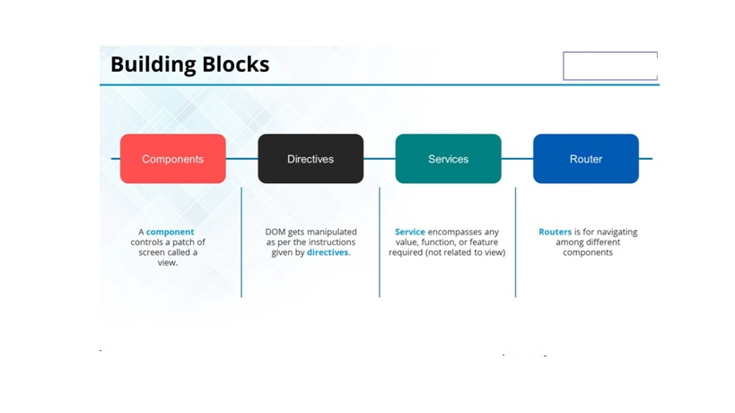

Slide 82
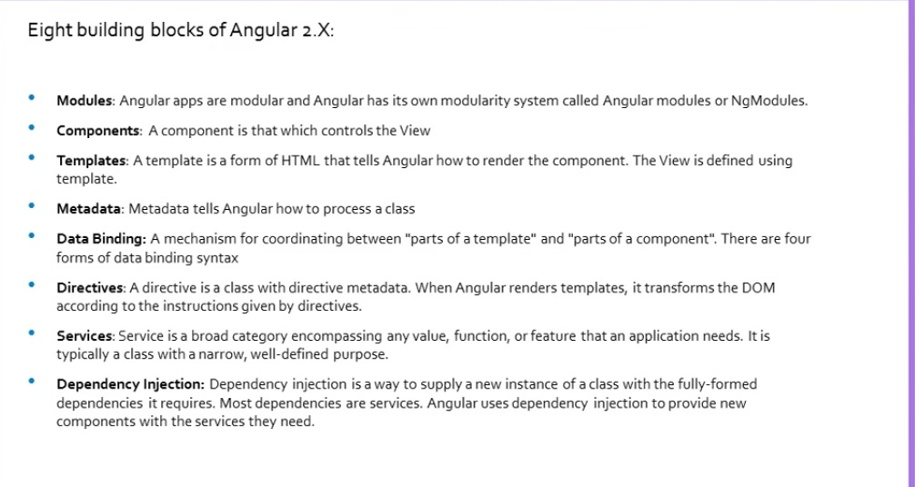

Slide 83
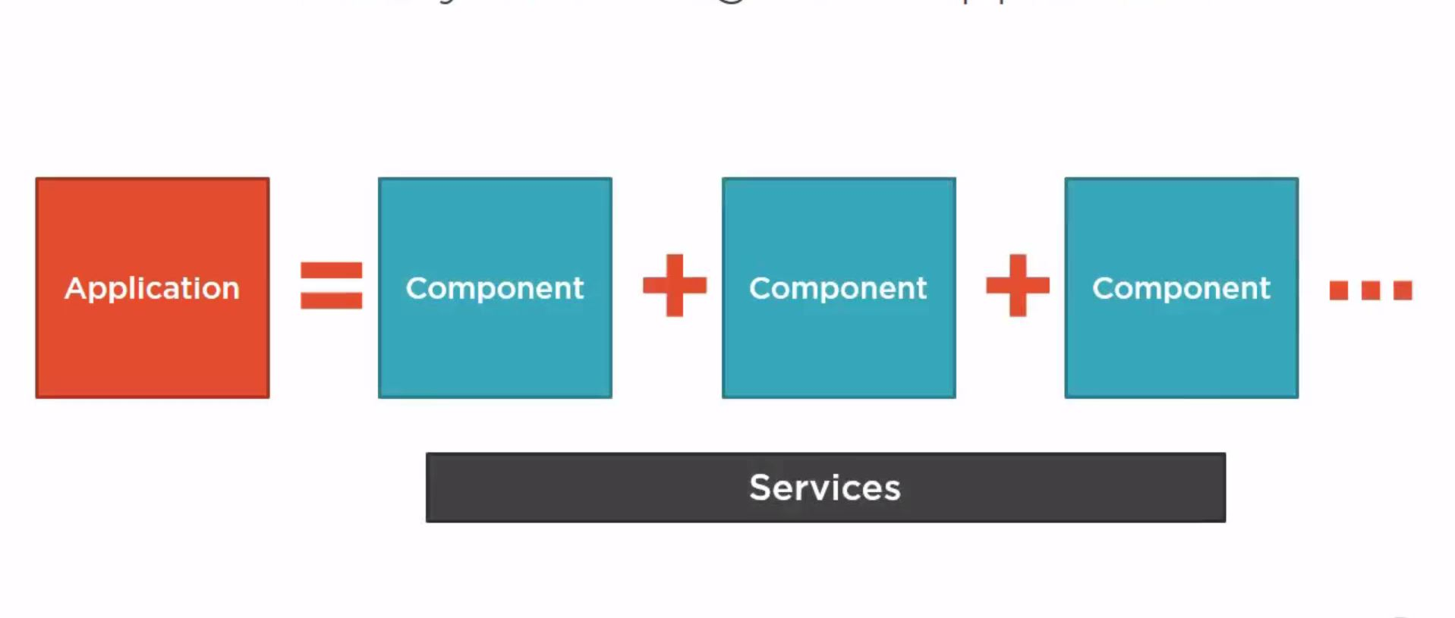
Structure of Angular Js 2

Slide 84
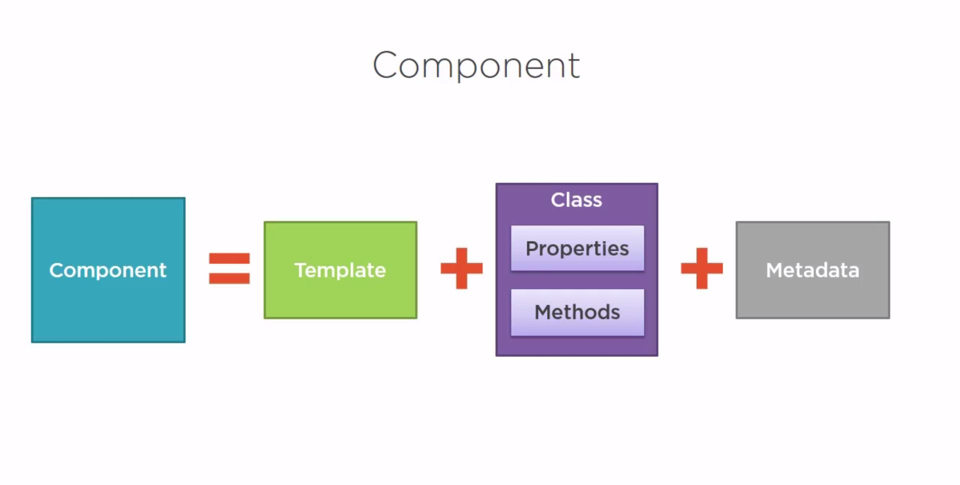
Component

Slide 85
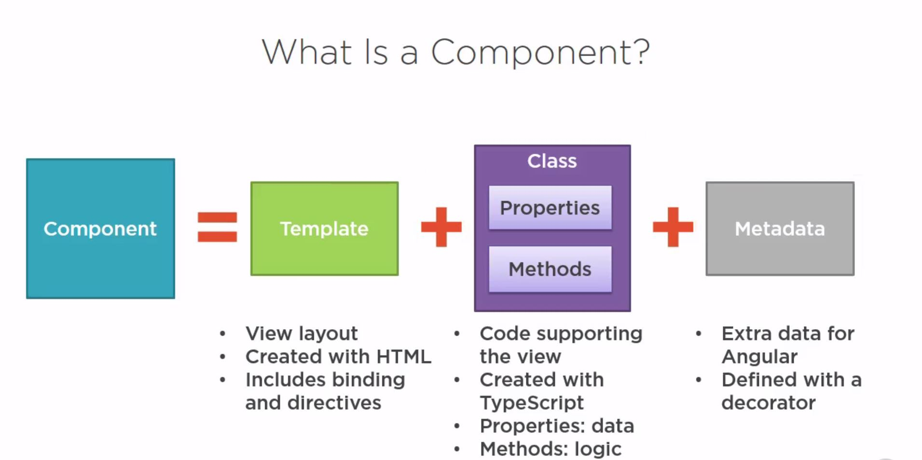
What is a component

Slide 86
Create Component, HTML Template and Styles
app.component.ts
import { Component } from '@angular/core';
@Component({
selector: 'msg-app',
templateUrl: 'app/app.component.html',
styleUrls: ['app/app.component.css']
})
export class AppComponent {
message = "Hello Angular 2 World with TypeScript";
}

Slide 87
Create Component, HTML Template and Styles
@Component decorator has been defined in angular core package. So we need to import it using import keyword. To import
@angular/core in component means we actually import node_modules/@angular/core/bundles/core.umd.js

Slide 88
Create Component, HTML Template and Styles
To understand @angular/core mapping with complete path, refer the file systemjs.config.js given in this example. Now find some metadata of @Component decorator. selector : Defines component element. templateUrl : Defines HTML template URL. template : Here we can write inline HTML code. styleUrls : Defines styles.

Slide 89
Create Component, HTML Template and Styles
Find the HTML template of AppComponent component. app.component.html
<h1> {{message}} </h1>
In above HTML template we are fetching value of component property message defined in AppComponent. Now find the CSS used in our example. app.component.css
h1 {
color: #369;
font-family: Arial, Helvetica, sans-serif;
font-size: 250%;
}
The above CSS has been defined in AppComponent, so this CSS will be applied only in its HTML template that is app.component.html .

Slide 90
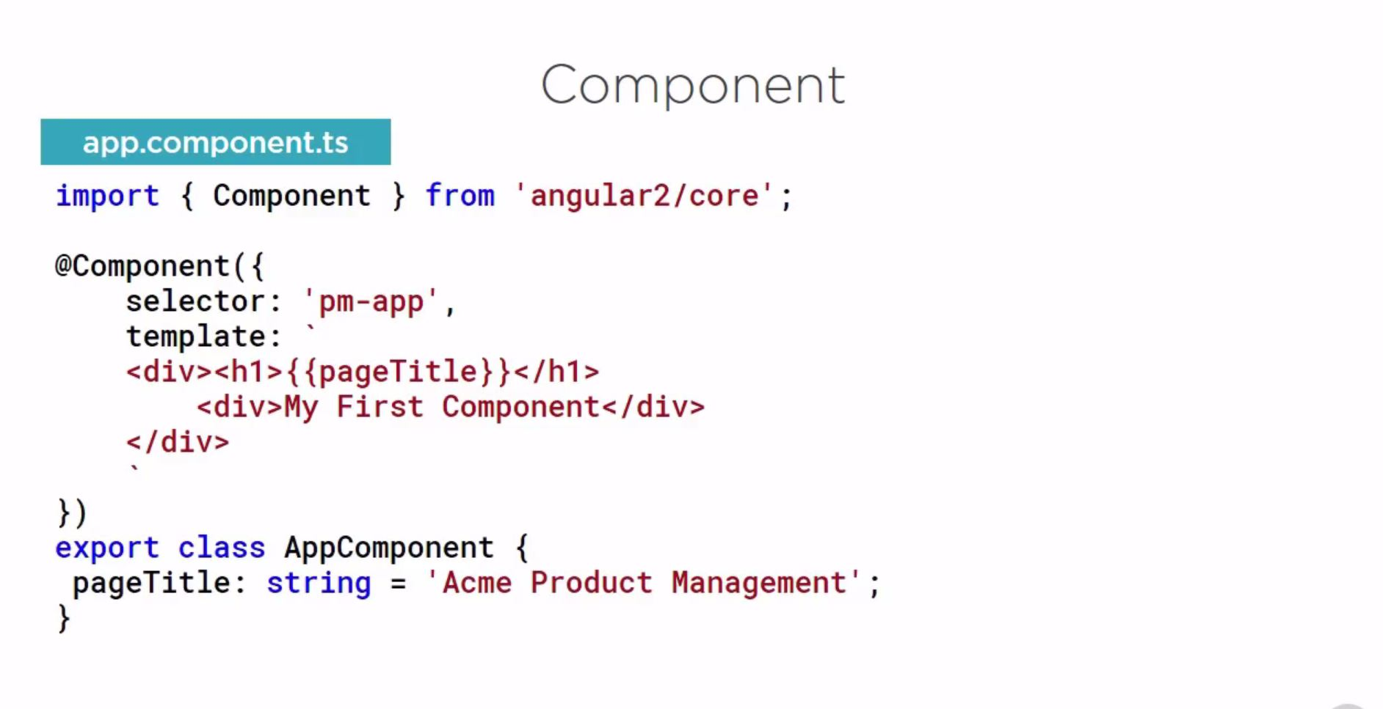
Component

Slide 91
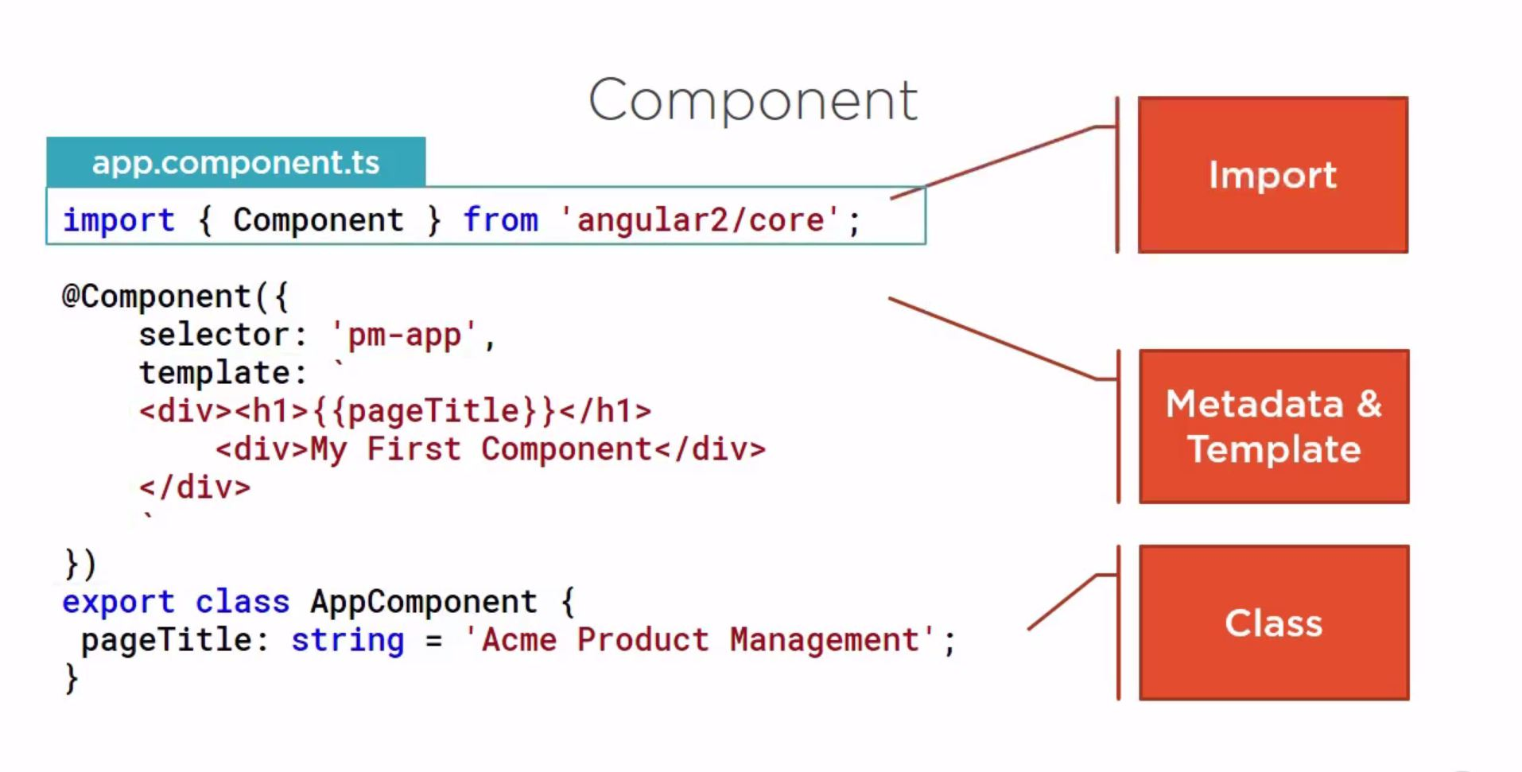
Component detail

Slide 92
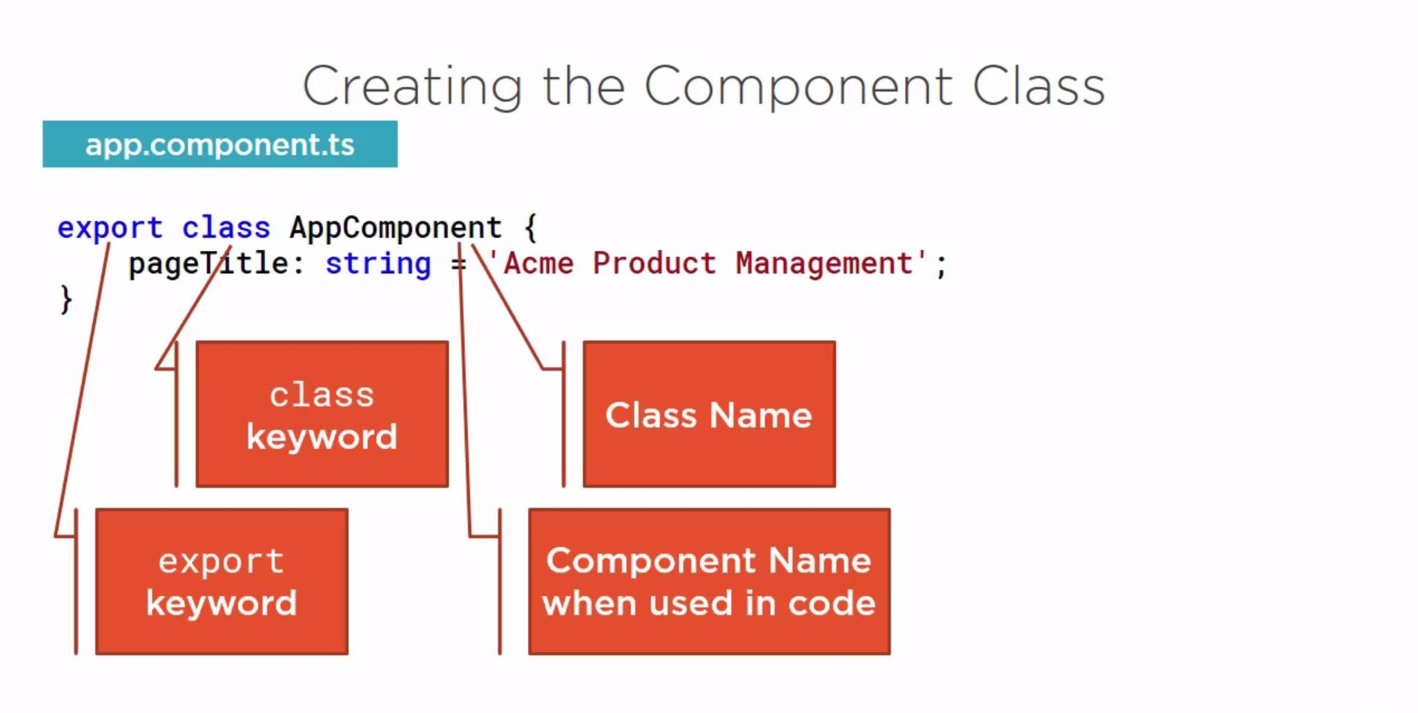
Component Class

Slide 93
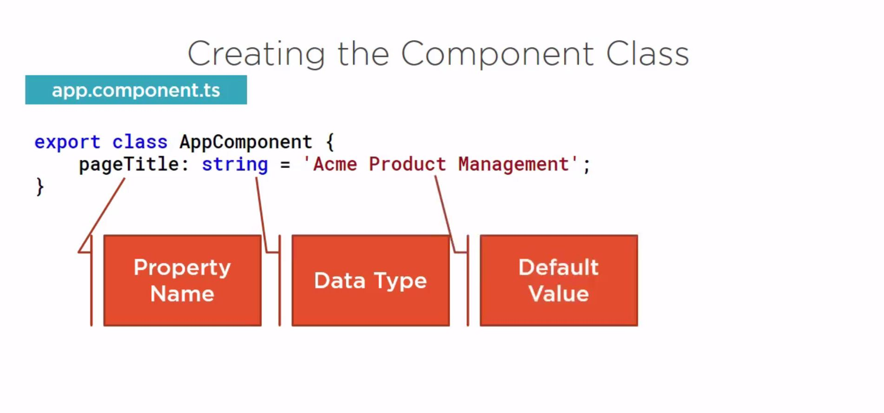
Component Class Properties

Slide 94
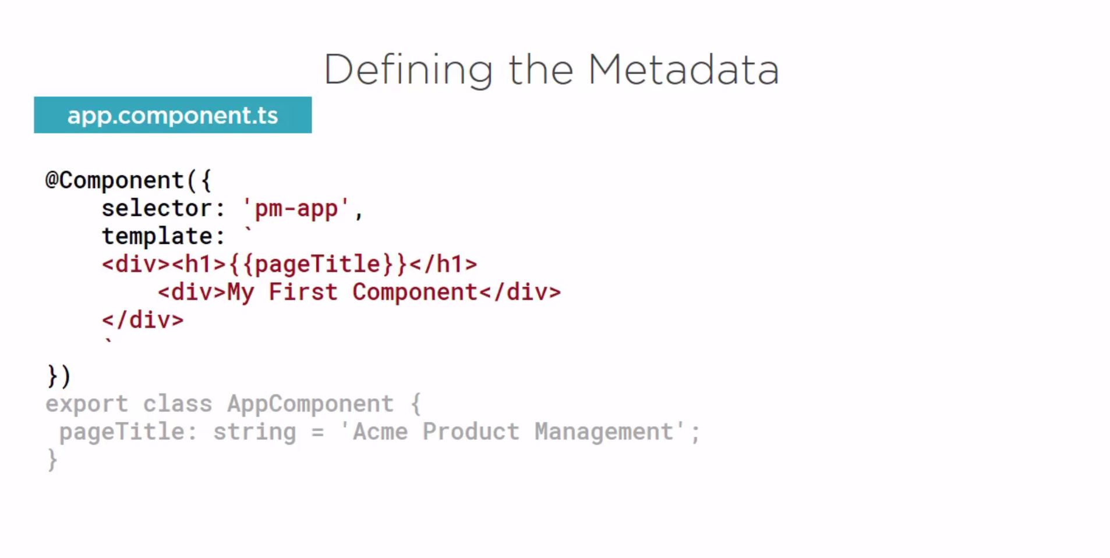
Defining the Metadata

Slide 95
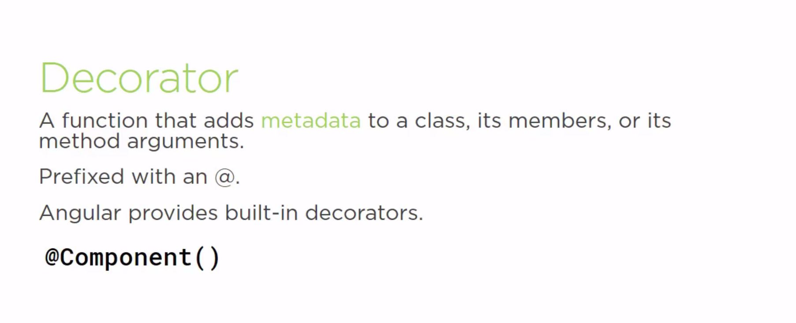
Decorator

Slide 96
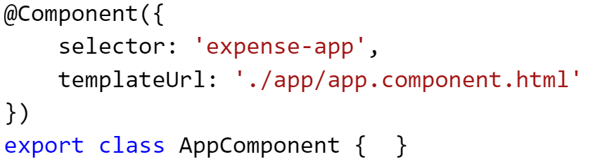
Decorators
Like attributes in C#/VB.NET

Slide 97
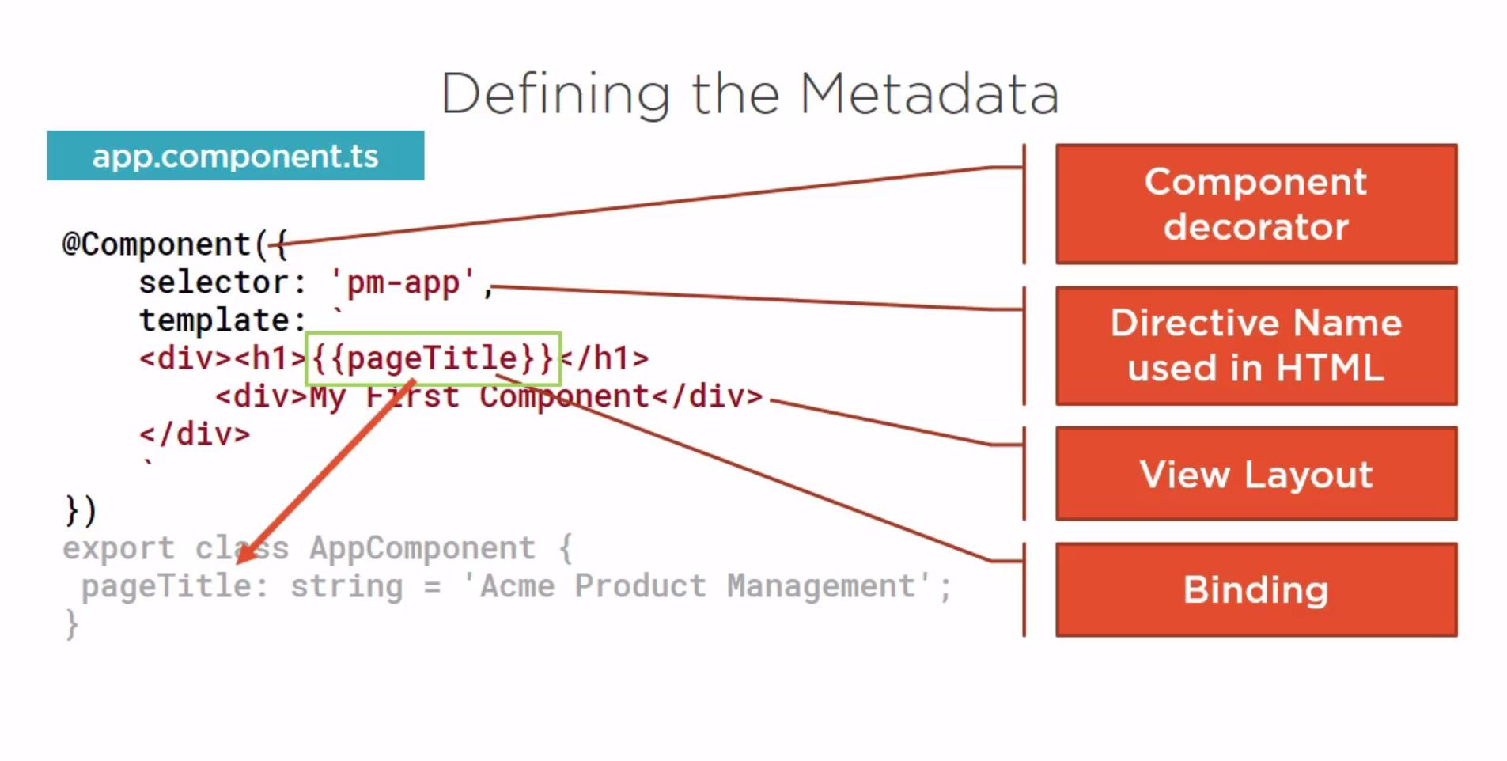
Defining the MetaData

Slide 98
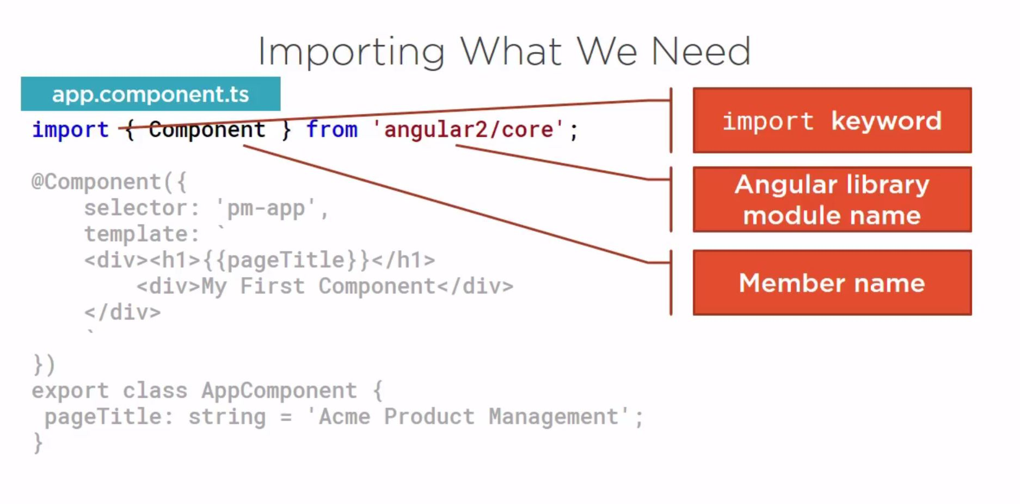
Importing What We Need

Slide 99
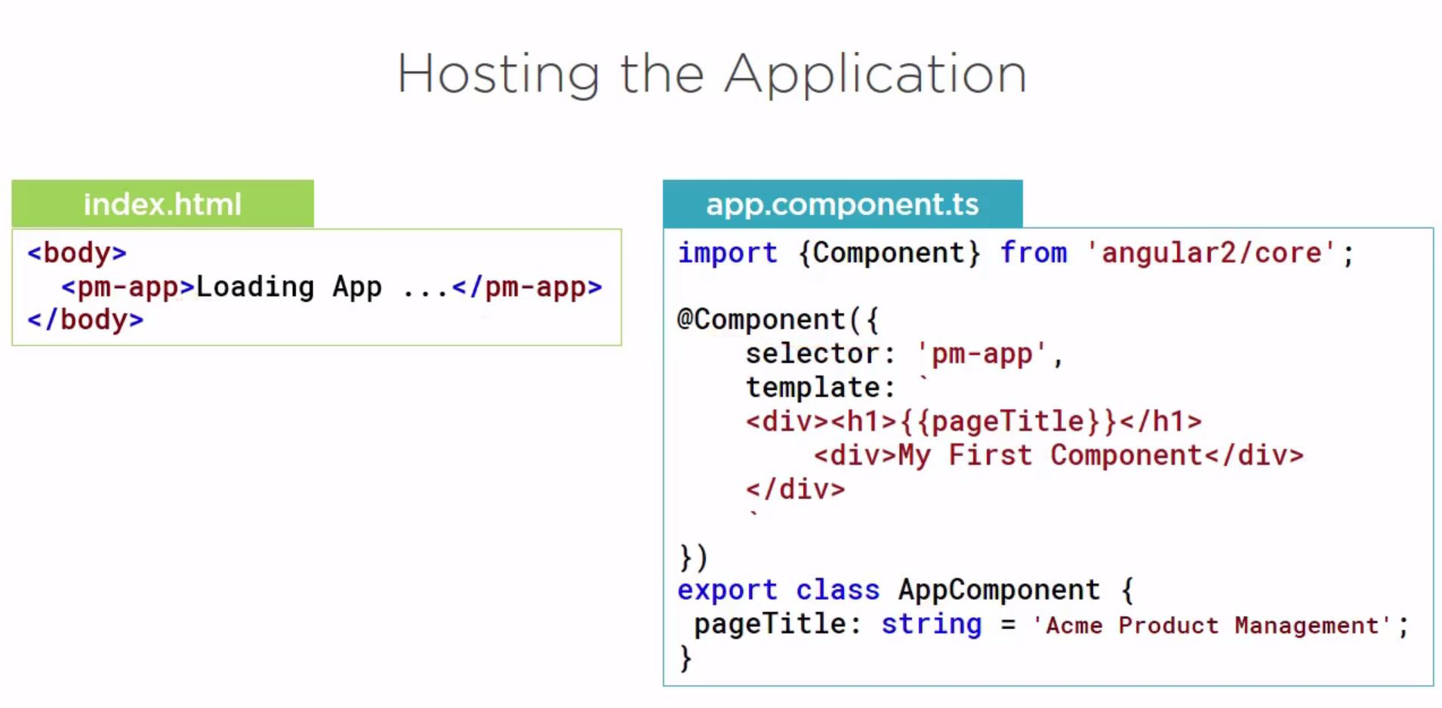
Hosting the Application

Slide 100
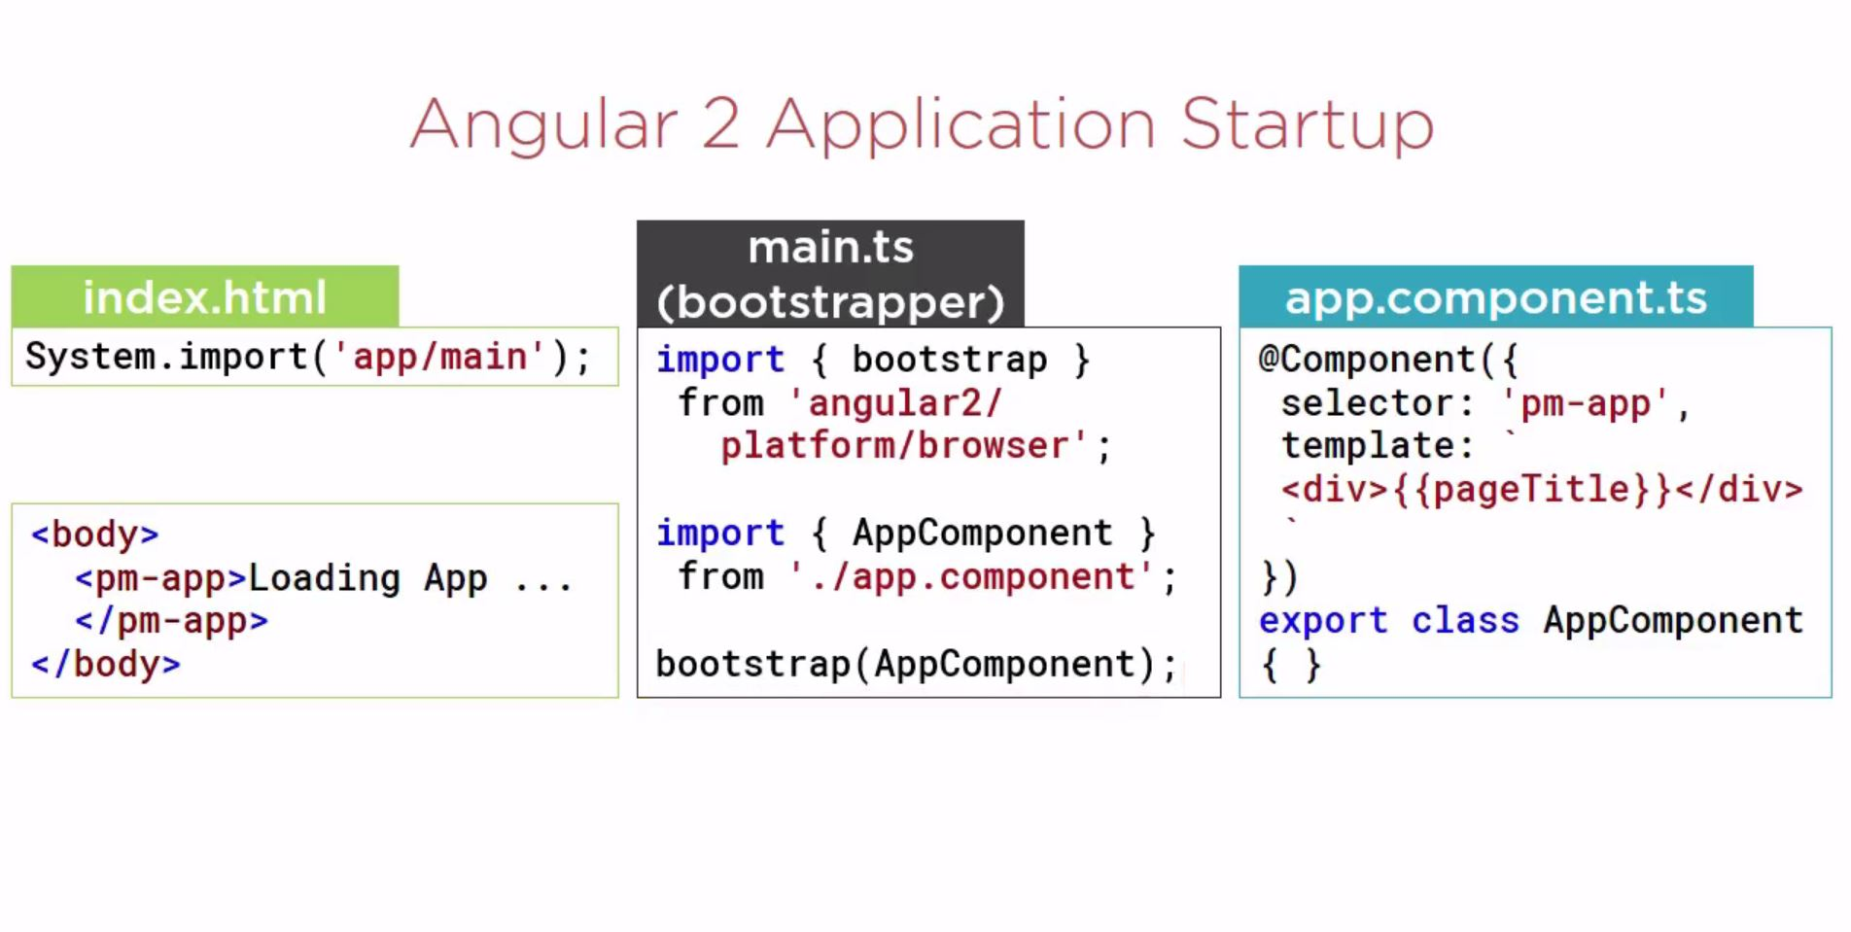
Angular 2 Application Startup

Slide 101
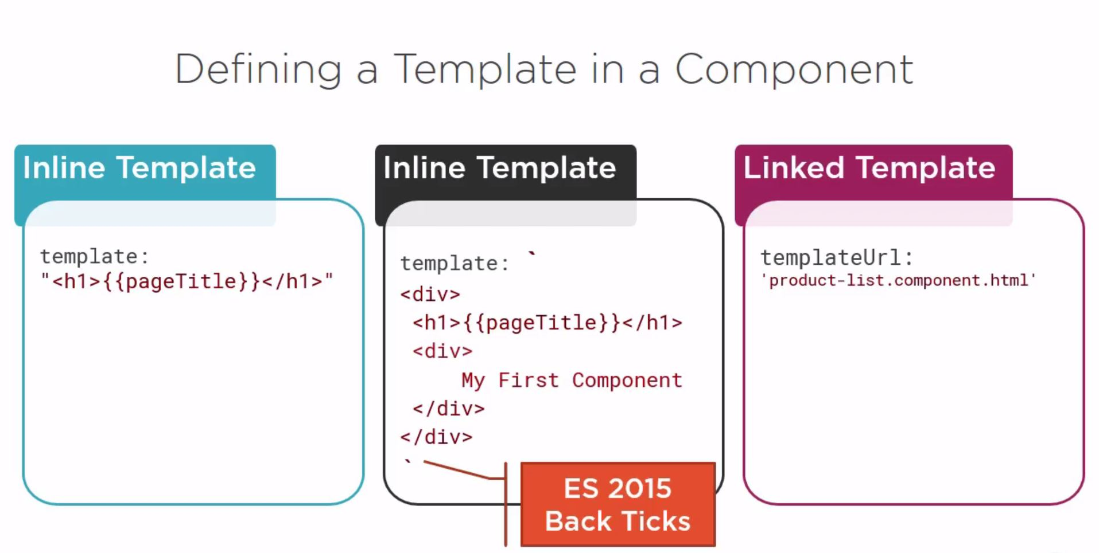
Defining a Template in a Component

Slide 102
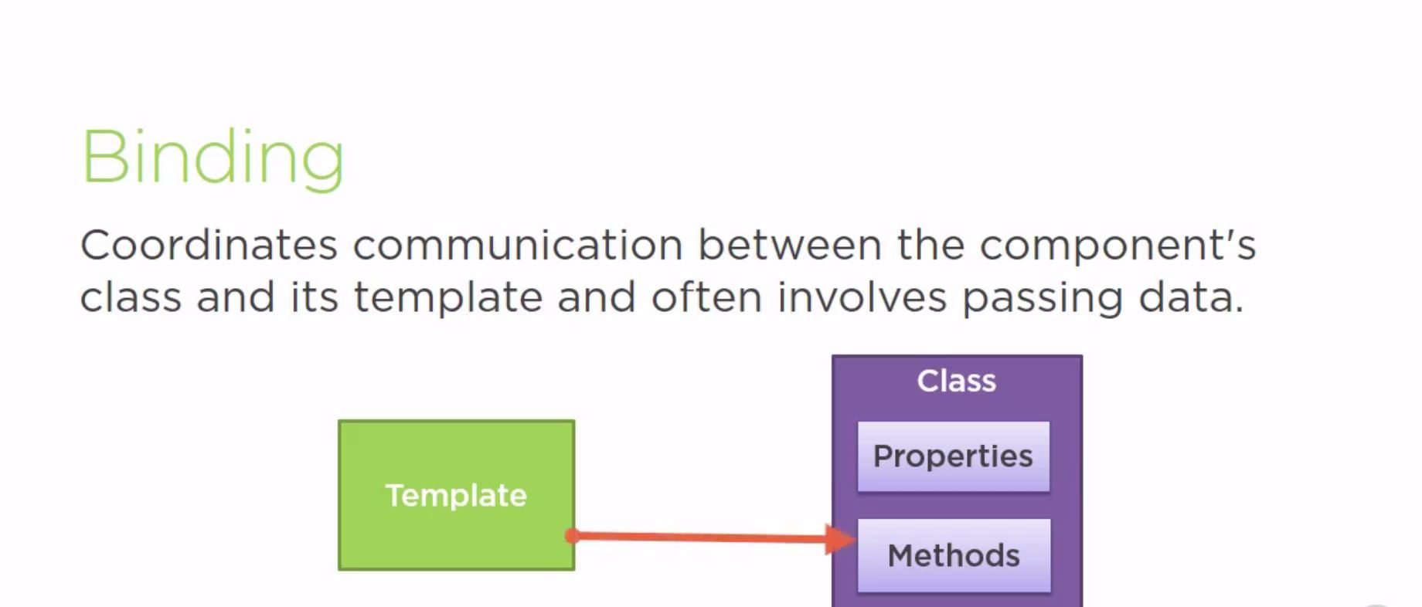
Binding

Slide 103
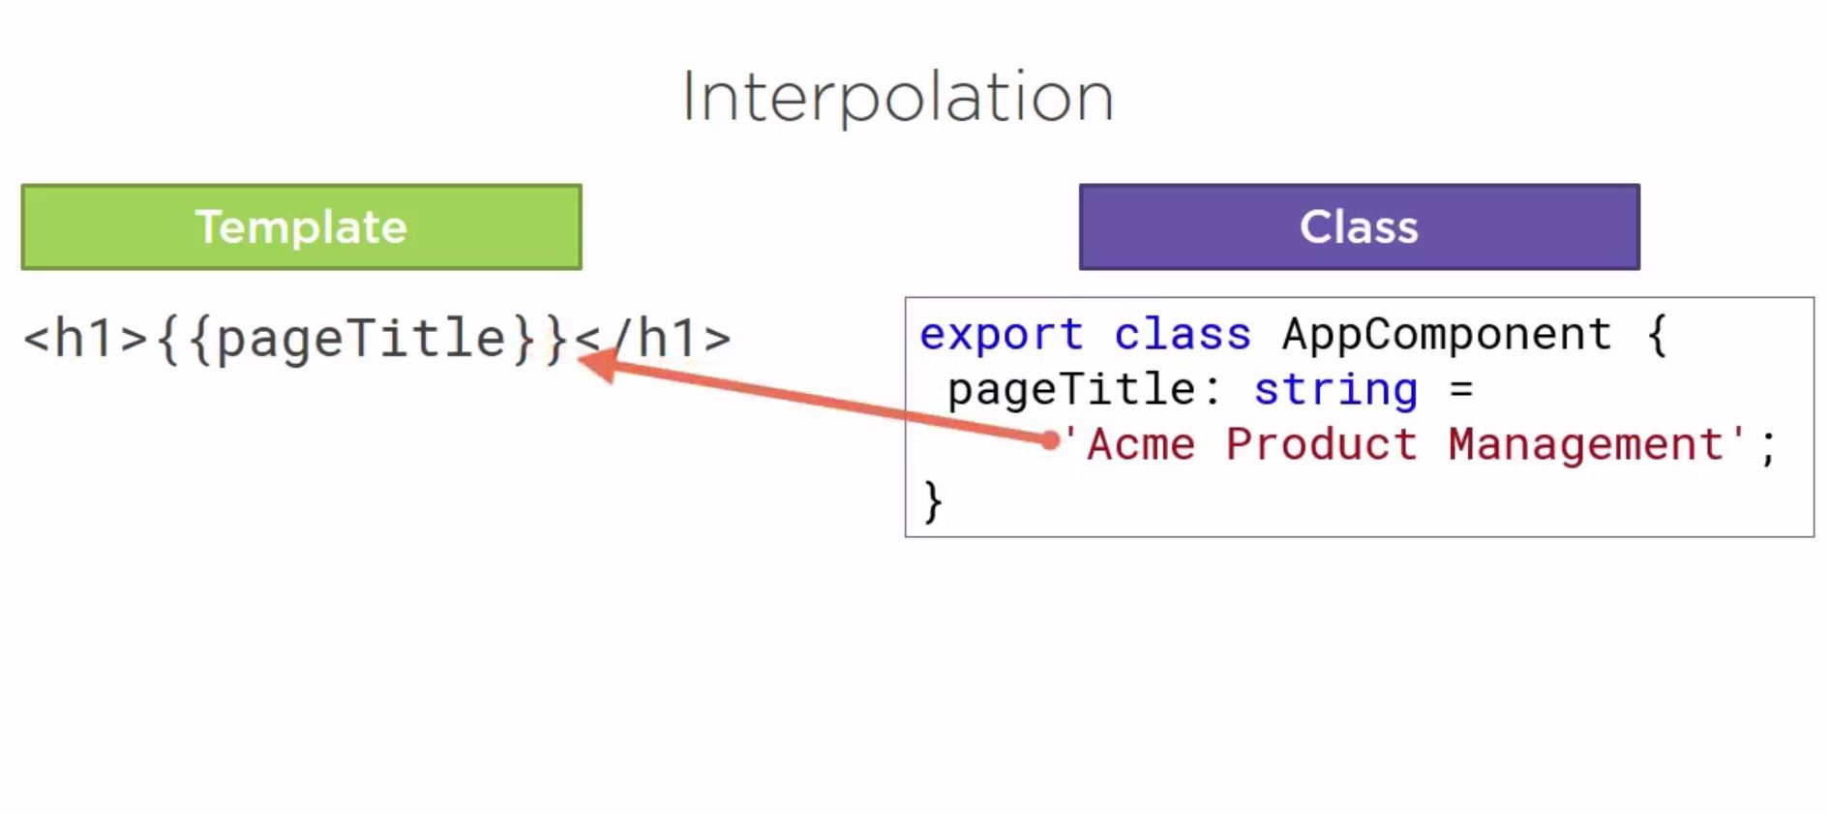
Interpolation

Slide 104
Declaring a component
Create your class
Import the Component decorator
Add a template and a selector

Slide 105
Templates in your component
@Component({
selector: 'my-app',
template: '<h1>This is some HTML</h1>'
})
export class AppComponent {}

Slide 106
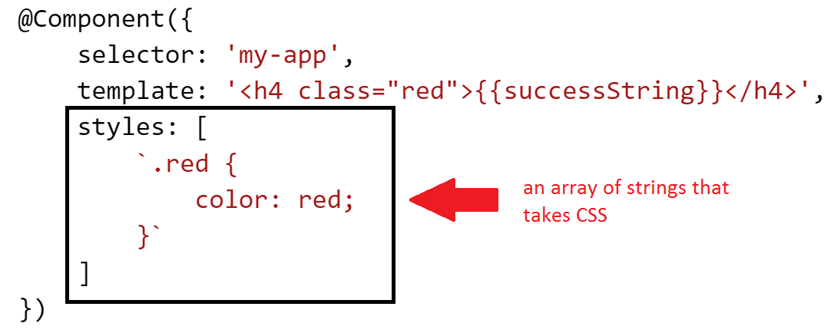
Styling a component
You can add CSS directly to a component!

Slide 107
Styling a component
Components :
import { Component } from '@angular/core';
@Component({
selector: 'my-component',
template: `
<div>Hello my name is {{name}}.
<button (click)="sayMyName()">Say my name</button>
</div>
`
})

Slide 108
Styling a component

Slide 109
Binding component to template
Interpolation expressions
Property binding
Event binding
ngModel

Slide 110
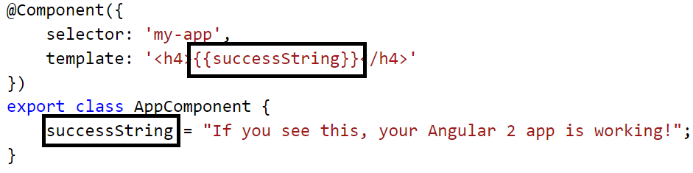
Interpolated expressions

Slide 111
Example: component
import {Component} from 'angular2/core';
@Component({ selector: 'my-app', template: ` <h1>{{title}}</h1> <h2>My favorite hero is: {{myHero}}</h2> ` }) export class AppComponent { title = 'Tour of Heroes'; myHero = 'Windstorm'; }
<body> <my-app>Loading...</my-app> </body>
index.html:

Slide 112
Example: component
import { Component } from '@angular/core';
@Component({
selector: 'my-component',
template: `
<div>Hello my name is {{name}}.
<button (click)="sayMyName()">Say my name</button>
</div>
`
})
export class MyComponent {
name: string;
constructor() {
this.name = 'Max'
}
sayMyName() {
console.log('My name is', this.name)
}
}

Slide 113
Example: component
import { Component } from '@angular/core';
@Component ({
selector: 'my-app',
template: ` <div>
<h1>{{appTitle}}</h1>
<div>Angular2 Componenets</div>
</div> `,
})
export class AppComponent {
appTitle: string = 'Welcome';
}

Slide 114
Example: component
import { Component } from '@angular/core'; @Component({ selector: 'my-app', templateUrl: './app.component.html' })export class AppComponent { name = 'Angular';
characters = [ 'Finn the human', 'Jake the dog', 'Princess bubblegum', 'Lumpy Space Princess', 'Beemo1', 'Beemo2' ]}

Slide 115
Example: component
Now lets modify app.component.html to display the characters in a list. Add this to the html file:
<ul> <li *ngFor="let c of characters"> {{c}} </li> </ul>

Slide 116
Example: component
Angular 2 - Data Binding Step 1 − Download any 2 images. For this example, we will download some simple images shown below.
Step 2 − Store these images in a folder called Images in the app directory. If the images folder is not present, please create it.

Slide 117
Example: component
Step 3 − Add the following content in app.component.ts as shown below.
import { Component } from '@angular/core';
@Component ({
selector: 'my-app',
templateUrl: 'app/app.component.html'
})
export class AppComponent {
appTitle: string = 'Welcome';
appList: any[] = [ {
"ID": "1",
"url": 'app/Images/One.jpg'
},
{
"ID": "2",
"url": 'app/Images/Two.jpg'
} ];
}

Slide 118
Example: component
Step 3 − Add the following content in app.component.ts as shown below.
import { Component } from '@angular/core';
@Component ({
selector: 'my-app',
templateUrl: 'app/app.component.html'
})
export class AppComponent {
appTitle: string = 'Welcome';
appList: any[] = [ {
"ID": "1",
"url": 'app/Images/One.jpg'
},
{
"ID": "2",
"url": 'app/Images/Two.jpg'
} ];
}

Slide 119
Example: component
In the above app.component.html file, we are accessing the images from the properties in our class.
Output
The output of the above program should be like this −

Slide 120
Example: component
In the above app.component.html file, we are accessing the images from the properties in our class.
Output
The output of the above program should be like this −

Slide 121
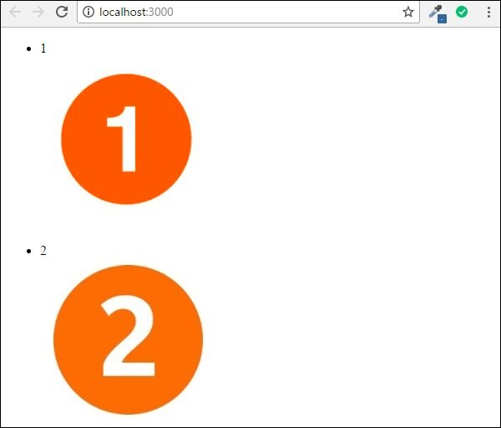
Example: component

Slide 122
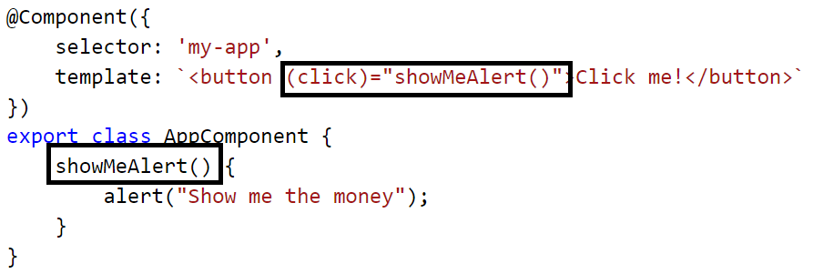
Event binding
Bind directly to events on the DOM model using ()

Slide 123
Event binding
Ng1 directive | Functionality | Replaced with
ng-click | Binds an expression to the click event | (click)=“doSomething()”
ng-change | Binds an expression to the input changed event | (change)=“prop = $event” (ngModelChange)=“”
ng-dblclick | Binds an expression to the double click event | (dblclick)=“onDoubleClick()”
ng-mouseover | …mouse over event
ng-mousemove | …mouse move event
…you get the idea

Slide 124
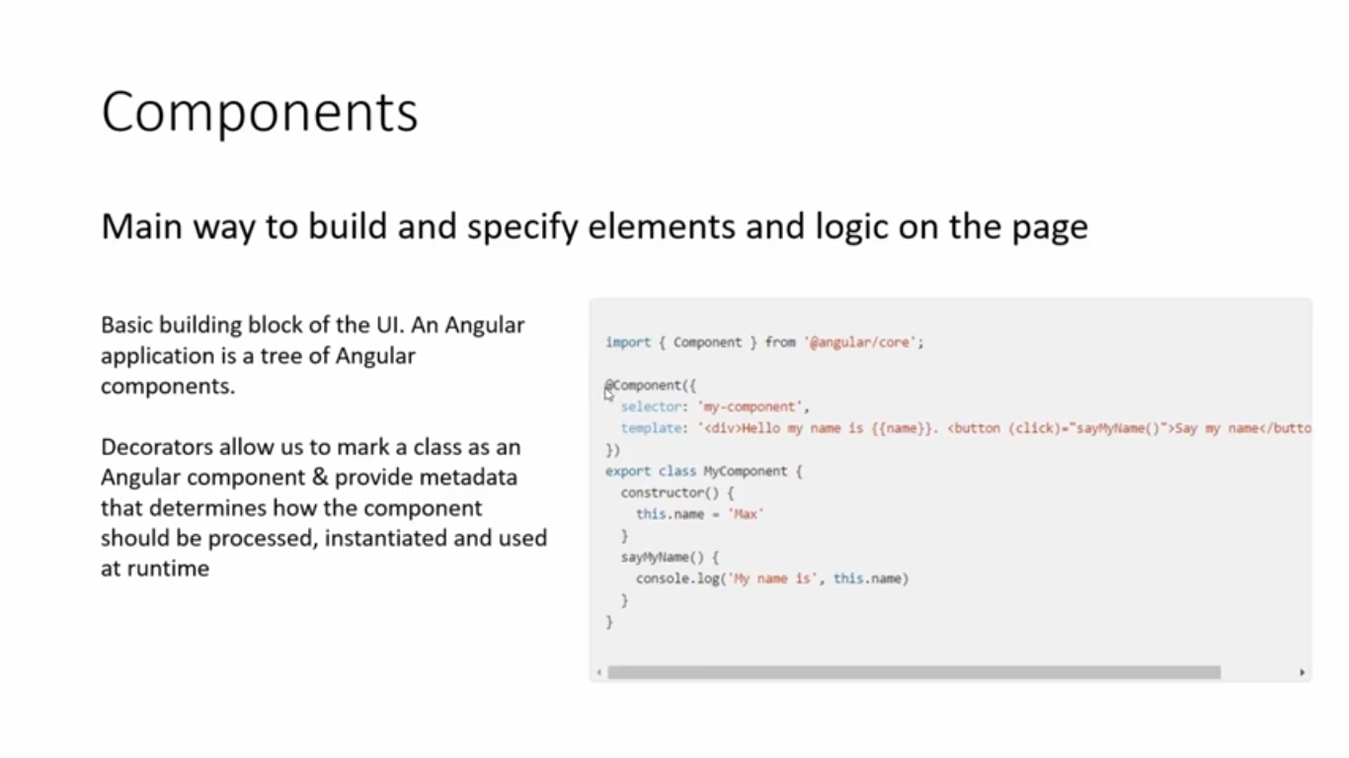

Slide 125
Example: work with the events
@Component({ selector: 'click-me', template: ` <button (click)="onClickMe()">Click me!</button> {{clickMessage}}` }) export class ClickMeComponent { clickMessage = ''; onClickMe() { this.clickMessage ='You are my hero!'; } }

Slide 126

Pipes

Slide 127
Using pipes
date
This is used to convert the input string to date format.
Syntax
Propertyvalue | date:”dateformat”
Parameters
dateformat − This is the date format the input string should be converted to.
Result
The property value will be converted to date format.

Slide 128
Using pipes
import { Component } from '@angular/core';
@Component ({
selector: 'my-app',
templateUrl: 'app/app.component.html'
})
export class AppComponent {
newdate = new Date(2016, 3, 15);
}

Slide 129

Using pipes
app/app.component.html file.
<div> The date is {{newdate | date:"MM/dd/yy"}}<br> </div>
Output

Slide 130
Using pipes
import {Component} from 'angular2/core' @Component({ selector: 'hero-birthday', template: `<p>The hero's birthday is {{ birthday | date }}</p>` }) export class HeroBirthday { birthday = new Date(1988,3,15); // April 15, 1988 }

Slide 131
Using pipes :
app/app.component.ts
import { Component } from '@angular/core';
@Component ({
selector: 'my-app',
templateUrl: 'app/app.component.html'
})
export class AppComponent {
Name1: string = 'Angular2';
appList: string[] = ["Binding", "Display", "Services"];
}

Slide 132
Using pipes :
app/app.component.html
<div>
The name is {{Name1}}<br>
The first Topic is {{appList[0] | lowercase}}<br>
The second Topic is {{appList[1] | lowercase}}<br>
The third Topic is {{appList[2]| lowercase}}<br>
</div>

Slide 133

Using pipes :
Output
Once you save all the code changes and refresh the browser, you will get the following output.

Slide 134
Using pipes :
app/app.component.html
<div>
The name is {{Name1}}<br>
The first Topic is {{appList[0] | uppercase}}<br>
The second Topic is {{appList[1] | uppercase}}<br>
The third Topic is {{appList[2]| uppercase}}<br>
</div>

Slide 135

Using pipes :
Output
Once you save all the code changes and refresh the browser, you will get the following output.

Slide 136
Using pipes : slice
This is used to slice a piece of data from the input string.
Propertyvalue | slice:start:end
Parameters
start − This is the starting position from where the slice should start.
end − This is the starting position from where the slice should end.
Result
The property value will be sliced based on the start and end positions.

Slide 137
Using pipes :SLICE
app/app.component.ts
import { Component } from '@angular/core';
@Component ({
selector: 'my-app',
templateUrl: 'app/app.component.html'
})
export class AppComponent {
Name1: string = 'Angular2';
appList: string[] = ["Binding", "Display", "Services"];
}

Slide 138
Using pipes :SLICE
<div>
The name is {{Name1}}<br>
The first Topic is {{appList[0] | slice:1:2}}<br>
The second Topic is {{appList[1] | slice:1:3}}<br>
The third Topic is {{appList[2]| slice:2:3}}<br>
</div>

Slide 139

Using pipes :SLICE
Output
Once you save all the code changes and refresh the browser, you will get the following output.

Slide 140
Using pipes :currency
This is used to convert the input string to currency format
Propertyvalue | currency
Result
The property value will be converted to currency format.

Slide 141
ngModel: Binding
import { Component } from '@angular/core';
@Component({
selector: 'app-hello-world',
template: `
<div>
<label>Name:</label>
<input type="text" [(ngModel)]="name">
<h1>Hello {{name}}!</h1>
</div>`
})
export class HelloWorldComponent {
name = 'World';
}

Slide 142
DATA BINDING
Text
We use two-way data binding with ngModel to bind to the textValue property on the component class.
Two-way binding allows us to use the property to set the initial value of an <input>, and then have the user's changes flow back to the property. We can also change the property value in the code and have these changes reflected in the <input>.

Slide 143
DATA BINDING : text.component.ts
import { Component } from '@angular/core';
@Component({
selector: 'app-text-box',
template: `
<h1>Text ({{textValue}})</h1>
<input #textbox type="text" [(ngModel)]="textValue" required>
<button (click)="logText(textbox.value)">Update Log</button>
<button (click)="textValue=''">Clear</button>
<h2>Template Reference Variable</h2>
Type: '{{textbox.type}}', required: '{{textbox.hasAttribute('required')}}',
upper: '{{textbox.value.toUpperCase()}}'
<h2>Log <button (click)="log=''">Clear</button></h2>
<pre>{{log}}</pre>`
})
export class TextComponent {
textValue = 'initial value';
log = '';
logText(value: string): void {
this.log += `Text changed to '${value}'\n`;
}
}

Slide 144
ngModel: Binding
import { Component } from '@angular/core';
@Component({
selector: 'app-two-way-binding',
template: `
<h1>
{{person.name.forename}} {{person.name.surname}}
({{person.address.street}}, {{person.address.city}}, {{person.address.country}})
</h1>
<p>
<input [value]="person.name.forename"
(keyup)="person.name.forename=$event.target.value">

Slide 145
ngModel: Two Way Binding
<input [value]="person.name.surname"
(input)="person.name.surname=$event.target.value">
</p>
<p>
Street: <input [ngModel]="person.address.street"
(ngModelChange)="person.address.street=$event">
</p>
<p>
City: <input [(ngModel)]="person.address.city">
</p>
<p>
Country: <input bindon-ngModel="person.address.country">
</p>
<p>

Slide 146
ngModel: Binding
<button (click)="reset()">Reset</button>
</p>
<pre>
{{person | json:2}}
</pre>`
})
export class TwoWayBindingComponent {
person: any;
constructor() {
this.reset();
}

Slide 147
ngModel: Binding
reset(): void {
this.person = {
name: {
forename: 'John',
surname: 'Doe'
},
address: {
street: 'Lexington Avenue',
city: 'New York',
country: 'USA'
}
};
}
}

Slide 148

ngModel: Binding

Slide 149
ngModel: Binding-TEXTAREA
import { Component } from '@angular/core';
@Component({
selector: 'app-text-area',
template: `
<h1>Text Area</h1>
<textarea ref-textarea [(ngModel)]="textValue" rows="4"></textarea><br/>
<button (click)="logText(textarea.value)">Update Log</button>
<button (click)="textValue=''">Clear</button>

Slide 150
ngModel: Binding-TEXTAREA
<h2>Log <button (click)="log=''">Clear</button></h2>
<pre>{{log}}</pre>`
})
export class TextAreaComponent {
textValue = 'initial value';
log = '';
logText(value: string): void {
this.log += `Text changed to '${value}'\n`;
}
}

Slide 151
ngModel: Two Way Binding-TEXTAREA
textarea behaves in a similar way to the textbox. Again, we use two-way data binding with ngModel to bind to the textValue property on the component class to keep user and programmatic changes in sync.
This time we use the canonical form to specify the template reference variable but we could just as easily used #textarea instead.

Slide 152

ngModel: Binding-TEXTAREA

Slide 153
ngModel: Two Way Binding-CHECKBOX
The change event is triggered when the user clicks on a checkbox. We use this event to pass a template reference variable into a function to log user action. We can determine whether or not the checkbox has been selected using the checked property of the argument.
We also use the checked property to highlight the selected checkbox labels using class bindings. This uses the styles property to set the text color to OrangeRed for all the selected checkboxes.

Slide 154
ngModel: Binding-CHECKBOX
import { Component } from '@angular/core';
@Component({
selector: 'app-checkbox',
template: `
<h1>Checkbox</h1>
<p>
<label [class.selected]="cb1.checked">
<input #cb1 type="checkbox" value="one" (change)="logCheckbox(cb1)"> One
</label>
<label [class.selected]="cb2.checked">
<input #cb2 type="checkbox" value="two" (change)="logCheckbox(cb2)"> Two
</label>
<label [class.selected]="cb3.checked">
<input #cb3 type="checkbox" value="three" (change)="logCheckbox(cb3)"> Three
</label>
</p>

Slide 155
ngModel: Binding-CHECKBOX
<h2>Log <button (click)="log=''">Clear</button></h2>
<pre>{{log}}</pre>`,
styles: ['.selected {color: OrangeRed;}']
})
export class CheckboxComponent {
log = '';
logCheckbox(element: HTMLInputElement): void {
this.log += `Checkbox ${element.value} was ${element.checked ? '' : 'un'}checked\n`;
}
}

Slide 156

ngModel: Binding-CHECKBOX

Slide 157
ngModel: Binding-CHECKBOX

Slide 158
ngModel: Binding-RADIO
The radio field behaves in a similar way to the checkbox. We use the change event on the <input> element to execute a template statement which passes a template reference variable into a component method.
The value property property of the HTMLInputElement argument is used to log user's selection. This value property corresponds to the value attribute of the HTML <input> element.

Slide 159
ngModel: Two Way Binding-RADIO
import { Component } from '@angular/core';
@Component({
selector: 'app-radio',
template: `
<h1>Radio</h1>
<p>
<label [class.selected]="r1.checked">
<input #r1 type="radio" name="r" value="one" (change)="logRadio(r1)"> One
</label>
<label [class.selected]="r2.checked">
<input #r2 type="radio" name="r" value="two" (change)="logRadio(r2)"> Two
</label>
<label [class.selected]="r3.checked">
<input #r3 type="radio" name="r" value="three" (change)="logRadio(r3)"> Three
</label>
</p>

Slide 160
ngModel: Binding-RADIO
<h2>Log <button (click)="log=''">Clear</button></h2>
<pre>{{log}}</pre>`,
styles: ['.selected {color: OrangeRed;}']
})
export class RadioComponent {
log = '';
logRadio(element: HTMLInputElement): void {
this.log += `Radio ${element.value} was selected\n`;
}
}

Slide 161

ngModel: Binding-RADIO

Slide 162
ngModel: Binding-Drop-down List
We use an array to populate the drop-down with a list of values. The built-in ngFor directive comes in handy here to loop through the array and set up the option values.
[(ngModel)] sets up two-way data binding on the select element. This will ensure that the drop-down list will display the current item when it is opened. When a new value is chosen from the list, two-way binding also ensures that the current property on the component is automatically updated.
An additional binding to the change event of the select element logs the user action by calling a method in the template statement.

Slide 163
ngModel: Binding-Drop-down List
import { Component } from '@angular/core';
@Component({
selector: 'app-drop-down',
template: `
<h1>Drop-down List</h1>
<select #select [(ngModel)]="current" (change)="logDropdown(select.value)">
<option *ngFor="let item of list" [value]="item.id">{{item.name}}</option>
</select>
<h2>Log <button (click)="log=''">Clear</button></h2>
<pre>{{log}}</pre>`
})

Slide 164
ngModel: Binding-Drop-down List
export class DropDownComponent {
list: any = [
{id: 1, name: 'one'},
{id: 2, name: 'two'},
{id: 3, name: 'three'}
];
current = 2;
log = '';
logDropdown(id: number): void {
const NAME = this.list.find((item: any) => item.id === +id).name;
this.log += `Value ${NAME} was selected\n`;
}
}

Slide 165

ngModel: Binding-Drop-down List

Slide 166
Property binding
import { Component } from '@angular/core';
@Component({
selector: 'app-property',
template: `
<h1 [textContent]="'Name: ' + person.name"></h1>
<button (click)="person = male" [disabled]="person.sex=='m'">Male</button>
<button (click)="person = female" [disabled]="person.sex=='f'">Female</button>

Slide 167
Property binding
<p><img [src]="person.photo" [alt]="person.name" [title]="person.name"></p>
<p [hidden]="!person.rating">
Rating: <span [innerHTML]="'&#10032;'.repeat(person.rating)"></span>
</p>`
})
export class PropertyComponent {
female = {
name: 'Turanga Leela',
sex: 'f',
rating: 4,
photo: 'assets/images/leela.jpg'
};

Slide 168
Property binding
male = {
name: 'Philip J. Fry',
sex: 'm',
photo: 'assets/images/fry.jpg'
};
person: any = this.female;
}

Slide 169

Property binding

Slide 170
Property binding
Property binding means that all sorts of previous built-in directives in Angular 1 go away
Ng1 Directive | Functionality | Replaced with
ng-disabled | Disables the control – used on inputs, selects, textareas | [disabled]=“expression”
ng-src/ng-href | Replacement for src/href properties since interpolation didn’t play well with them | [src]=“expression” [href]=“expression”
ng-show/ng-hidden | Hides/shows an element based on the truthiness of an expression | [hidden]=“expression”

Slide 171
Property binding
Text
We use two-way data binding with ngModel to bind to the textValue property on the component class.
Two-way binding allows us to use the property to set the initial value of an <input>, and then have the user's changes flow back to the property. We can also change the property value in the code and have these changes reflected in the <input>.

Slide 172
Property binding
import { Component } from '@angular/core';
@Component({
selector: 'app-text-box',
template: `
<h1>Text ({{textValue}})</h1>
<input #textbox type="text" [(ngModel)]="textValue" required>
<button (click)="logText(textbox.value)">Update Log</button>
<button (click)="textValue=''">Clear</button>
<h2>Template Reference Variable</h2>
Type: '{{textbox.type}}', required: '{{textbox.hasAttribute('required')}}',
upper: '{{textbox.value.toUpperCase()}}'

Slide 173
Property binding
<h2>Log <button (click)="log=''">Clear</button></h2>
<pre>{{log}}</pre>`
})
export class TextComponent {
textValue = 'initial value';
log = '';
logText(value: string): void {
this.log += `Text changed to '${value}'\n`;
}
}

Slide 174

Property binding

Slide 175
What is Angular Module?
Angular apps are modular and Angular has its own modularity system called Angular modules or NgModules. Every Angular app should have at least one module class, the root module. We bootstrap that module to launch the application. Angular 2 NgModules contains imports, declarations, and bootstrap. imports - other modules whose exported classes are needed by component templates declared in this module. declarations - the view classes that belong to this module. Angular has three kinds of view classes: components, directives, and pipes. bootstrap - the main application view, called the root component, that hosts all other app views. Only the root module should set this bootstrap property.

Slide 176
What is Angular Module?
import {NgModule} from '@angular/core'
import {BrowserModule} from '@angular/platform-browser'
import {AppComponent} from './app.component'
@NgModule({
imports: [BrowserModule],
declarations: [AppComponent],
bootstrap: [AppComponent]
})
export class AppModule{
}

Slide 177
ANGULAR ROUTING AND SINGLE PAGE APPLICATION

Slide 178
What is the Angular 2 Router?
The router enables navigation from one view to the next as users perform application tasks.

Slide 179
What is Routing in AngularJS?
If you want to navigate to different pages in your application, but you also want the application to be a SPA (Single Page Application), with no page reloading, you can use the ngRoute module.
The ngRoute module routes your application to different pages without reloading the entire application.

Slide 180
Angular 2 Router & Navigation
Angular 2 is known for single page applications (SPA's), but even in such applications, you need a way to navigate between different views (defined by components).

Slide 181
What is single page application?
a web application that fits on a single web page
providing a more fluid user experience similar to a desktop application
Condition:
all necessary code is retrieved with a single page load
the page does not reload at any point in the process
does not control transfer to another page

Slide 182
SINGLE PAGE APPLICATION
A single-page application (SPA), is defined as a web application or web site that fits on a single web page with the goal of providing a more fluid user experience akin to a desktop application. In a SPA, either all necessary code – HTML, JavaScript, and CSS – is retrieved with a single page load or the appropriate resources are dynamically loaded and added to the page as necessary, usually in response to user actions.

Slide 183
SINGLE PAGE APPLICATION
The page does not reload at any point in the process, nor does control transfer to another page, although modern web technologies (such as those included in HTML5) can provide the perception and navigability of separate logical pages in the application. Interaction with the single page application often involves dynamic communication with the web server behind the scenes.

Slide 184
SPA
So how does this technology compare to ASP.NET Master Pages? Well ASP.NET Master Pages allow you to create a consistent layout for the pages in your application. A single master page defines the look and feel and standard behavior that you want for all of the pages (or a group of pages) in your application.

Slide 185
SPA
You can then create individual content pages that contain the content you want to display. When users request the content pages, they merge with the master page to produce output that combines the layout of the master page with the content from the content page.

Slide 186
SPA BENEFITS
Runs faster
Gives better UX
Is able to operate offline (thanks to HTML5)
Uses less network bandwidth

Slide 187
ANGULAR 2
HOW TO CREATE ANGULAR2 ROUTING/SPA

Slide 188
Angular 2 Router?
Step 1: create project
-ng new web-router
-ng serve --open
Step 2: Create 2 Components
-ng generate component about
-ng g c services
-ng serve --open
Step 3: Create an app.router.ts file
create a route module to store our routing information specifically. Place it within the /app folder.

Slide 189
app.router.ts
import { ModuleWithProviders } from '@angular/core';
import { Routes, RouterModule } from '@angular/router';
import { AppComponent } from './app.component';
import { AboutComponent } from './about/about.component';
import { ServicesComponent } from './services/services.component';

Slide 190
app.router.ts
export const router: Routes = [
{ path: '', redirectTo: 'about', pathMatch: 'full' },
{ path: 'about', component: AboutComponent },
{ path: 'services', component: ServicesComponent }
];
export const routes: ModuleWithProviders = RouterModule.forRoot(router);

Slide 191
app.router.ts
In a nutshell, we're importing the necessary routing members on the first 2 lines. Then we're importing the components that currently exist within our application.
After that, we're defining a constant that contains the routes that we wish to create. "path" defines the URL; so "about" becomes http://someurl.com/about -- then we specify the component associated with that view.

Slide 192
app.module.ts
Step 3: Import the router to app.module.ts
import { routes } from './app.router';
import { AppComponent } from './app.component';
import { AboutComponent } from './about/about.component';
import { ServicesComponent } from './services/services.component'; @NgModule({
declarations: [
AppComponent,
AboutComponent,
ServicesComponent
],
imports: [
BrowserModule,
routes
],
providers: [],
bootstrap: [AppComponent]
})
export class AppModule { }

Slide 193
app.component.html
Step 4:
Now within app.component.html, we add:
<div>
<router-outlet></router-outlet>
</div>
<div>
<ul class="nav navbar-nav">
<li>
<a routerLink="about">About</a>
</li>
<li>
<a routerLink="services">Services</a>
</li>
</ul>
</div>

Slide 194
Angular Router
Step 6: Ensure <base href="/"> is in index.html
If you used the angular-cli to create the project you're working with, it will automatically add this in the head tag. If it's not there, add it:
<base href="/">

Slide 195

Using a Component as a Directive For Add Step 1

Slide 196

Using a Component as a Directive For Add Step 2.0

Slide 197

Using a Component as a Directive For Add Step 2.1

Slide 198

Using a Component as a Directive For Add Step 3

Slide 199
Example: show the list of heroes
export class AppComponent { title = 'Tour of Heroes'; heroes = ['Windstorm', 'Bombasto', 'Magneta', 'Tornado']; myHero = this.heroes[0]; }
template: ` <h1>{{title}}</h1> <h2>My favorite hero is: {{myHero.name}}</h2> <p>Heroes:</p> <ul> <li *ngFor="#hero of heroes"> {{ hero.name }} </li> </ul> <p *ngIf="heroes.length > 3">There are many heroes!</p> `

Slide 200
Example: create class for data and fill it
hero.ts:
export class Hero { constructor( public id:number, public name:string) { } }
app.component.ts:
export class AppComponent { title = 'Tour of Heroes'; heroes = [ new Hero(1, 'Windstorm'), new Hero(13, 'Bombasto'), new Hero(15, 'Magneta'), new Hero(20, 'Tornado') ]; myHero = this.heroes[0]; }

Slide 201
Example: adding hero form
@Component({ selector: 'little-tour', template: ` <input #newHero (keyup.enter)="addHero(newHero.value)" (blur)="addHero(newHero.value); newHero.value='' "> <button (click)=addHero(newHero.value)>Add</button> <ul><li *ngFor="#hero of heroes">{{hero}}</li></ul> ` }) export class LittleTourComponent { heroes=['Windstorm', 'Bombasto', 'Magneta', 'Tornado']; addHero(newHero:string) { if (newHero) { this.heroes.push(newHero); } } }

Slide 202
ngModel
Allows two-way binding
Follows unidirectional data flow concepts

Slide 203
Create Module
module.ts
import {NgModule} from '@angular/core';
import {BrowserModule} from '@angular/platform-browser';
import {AppComponent} from './app.component';
@NgModule({
imports: [BrowserModule],
declarations: [AppComponent],
bootstrap: [AppComponent]
})
export class AppModule { }

Slide 204
Child components
A child component is a component that exists within a component
I know, pretty crazy right?

Slide 205


Slide 206

Directive

Slide 207

Built in Directive

Slide 208

Custom Directive

Slide 209

ngIf

Slide 210

ngFor

Slide 211

for of vs for in

Slide 212
Data Binding and Pipes.
Property Binding
Handling Events with Event Binding
Handling Input with Two-way Binding.
Transforming Data with Pipes

Slide 213

Property binding

Slide 214

Property Binding Example

Slide 215

Event Binding

Slide 216

Pipe Example

Slide 217

Data Binding Ways

Slide 218


Slide 219


Slide 220

ANGULAR2 BOOTSTRAPING

Slide 221

ANGULAR2 REQUIREMENTS

Slide 222

GET-> SET ->GO

Slide 223
Create Module
To create angular module we need to import NgModule, BrowserModule and our components that we have created.
All the components must be configured in declarations metadata of @NgModule decorator. The main component which will start other sub component must be configured in bootstrap metadata of @NgModule decorator.

Slide 224
Create Main TS File
The syntax for module bootstrap is as follows.
platformBrowserDynamic().bootstrapModule(AppModule);
Now find our main TS file. main.ts
import {platformBrowserDynamic} from '@angular/platform-browser-dynamic';
import {AppModule} from './module';
const platform = platformBrowserDynamic();
platform.bootstrapModule(AppModule);
Here we will configure our module that is AppModule .

Slide 225
Create index.html
<html>
<head>
<title>Angular 2 Demo</title>
<meta charset="UTF-8">
<meta name="viewport" content="width=device-width, initial-scale=1">
<script src="node_modules/core-js/client/shim.min.js"></script>
<script src="node_modules/zone.js/dist/zone.js"></script>
<script src="node_modules/reflect-metadata/Reflect.js"></script>
<script src="node_modules/systemjs/dist/system.src.js"></script>
<!-- Configure SystemJS -->

Slide 226
<script src="systemjs.config.js"></script>
<script>
System.import('myApp').catch(function(err){ console.error(err); });
</script>
</head>
<body>
<msg-app>Please Wait...</msg-app>
</body>
</html>

Slide 227


Slide 228


Slide 229


Slide 230

Main reason why TypeScript is great
“TypeScript doesn’t try to NOT be JavaScript – it just tries to make JavaScript better”
–Me

Slide 231

Interfaces

Slide 232


Interfaces

Slide 233

Interfaces
“If it walks like a duck and quacks like a duck… it’s a duck”

Slide 234

Classes

Slide 235

Using classes

Slide 236

Constructor/property shorthand

Slide 237


import/export
Like using statements in C#/VB.NET
import statements allow us to reference code from other TypeScript files
export simply means public

Slide 238

Modules

Slide 239

Running your app
Import your root NgModule
Bootstrap it!

Slide 240
Step 2: Import it to your containing module
import { ChildComponent } from "./child.component";
@NgModule({
declarations: [AppComponent]
})
export class AppModule {
}

Slide 241
Step 3: Register
import { ChildComponent } from "./child.component";
@NgModule({
declarations: [AppComponent, ChildComponent]
})
export class AppModule {
}

Slide 242



Step 4: Add child selector to markup

Slide 243
But how do components talk??
Inputs and Outputs

Slide 244

Step 1: Add the input property

Slide 245

Step 2: Bind the parent property to that property

Slide 246

Import and implement

Slide 247

Add subscribing function

Slide 248

Emit your event

Slide 249

What are Services?
Services are best used to create, read, update and delete data
Enforces separation of concerns
Think of it like this: you don’t want your database in your view!

Slide 250
Services in Angular 1
In Angular 1, we had 5 different kinds of services:
Provider
Service
Factory
Value
Constants
In Angular 2, we have 1 kind of service:
Service
Which do you prefer?

Slide 251

Step 1 – Make class with data

Slide 252

Step 2 – Import @Injectable and decorate

Slide 253

Steps 3 and 4 – Import and register

Slide 254

Step 5 – Add as property and to constructor

Slide 255

Services
Components should know who can do something for them, not how to do it.

Slide 256
EXAMPLES

Slide 257

Big picture

Slide 258

Modules
app/app.component.ts:
export class AppComponent { }
app/boot.ts:
import {AppComponent} from './app.component';

Slide 259

Library modules
import {Component} from 'angular2/core';
Angular apps are composed of modules.
Modules export things — classes, function, values — that other modules import.
We prefer to write our application as a collection of modules, each module exporting one thing.

Slide 260

Component
app/hero-list.component.ts
export class HeroListComponent implements OnInit {
constructor(private _service: HeroService){ }
heroes: Hero[];
selectedHero: Hero;
ngOnInit(){
this.heroes = this._service.getHeroes();
}
selectHero(hero: Hero) { this.selectedHero = hero; }
}

Slide 261

Template
app/hero-list.component.html
<h2>Hero List</h2>
<p><i>Pick a hero from the list</i></p>
<div *ngFor="#hero of heroes" (click)="selectHero(hero)">
{{hero.name}}
</div>
<hero-detail *ngIf="selectedHero" [hero]="selectedHero">
</hero-detail>

Slide 262

Metadata
@Component({
selector: 'hero-list',
templateUrl: 'app/hero-list.component.html',
directives: [HeroDetailComponent],
providers: [HeroService]
})
export class HeroesComponent { ... }
selector - a css selector that tells Angular to create and insert an instance of this component where it finds a <hero-list> tag in parent HTML: <hero-list></hero-list>
Angular inserts an instance of the HeroListComponent view between tags.
templateUrl - the address of this component's template
directives - an array of the Components or Directives this template requires
providers - an array of dependency injection providers for services that the component requires

Slide 263


Data binding
app/hero-list.component
<div>{{hero.name}}</div> <hero-detail [hero]="selectedHero”></hero-detail> <div (click)="selectHero(hero)></div>

Slide 264
Example: execute
boot.ts
import {bootstrap} from 'angular2/platform/browser' import {AppComponent} from './app.component' bootstrap(AppComponent);
package.json
name, version
dependencies (SystemJS is used as module system)
devDependencies
tsconfig.json
TypeScript configuration
npm start

Slide 265
Binding in templates
Data Direction | Syntax | Binding Type
One way from data source to view target | {{expression}} [target] = "expression" bind-target = "expr" | Interpolation Property Attribute Class Style
One way from view target to data source | (target) = "expression" on-target = "expr" | Event
Two way | [(target)] = "expr" bindon-target = "expr" | Two-way

Slide 266
Binding targets
Binding Type | Target | Examples
Property | Element Property | <img [src] = "heroImageUrl">
 | Component Property | <hero-detail [hero]="currentHero"> </hero-detail>
 | Directive property | <div [ngClass] = "{selected: isSelected}"> </div>
Event | Element Event | <button (click) = "onSave()"> Save </button>
 | Component Event | <hero-detail (deleted)="onHeroDeleted()"> </hero-detail>
 | Directive Event | <div myClick (myClick)="clicked=$event">click me</div>
Two-way | Directive Event Property | <input [(ngModel)]="heroName">

Slide 267
Binding targets
Binding Type | Target | Examples
Attribute | Attribute (the exception) | <button [attr.aria-label]="help"> help </button>
Class | class Property | <div [class.special]="isSpecial"> Special </div>
Style | style Property | <button [style.color] = "isSpecial ? 'red' : 'green'">

Slide 268

Dependency Injection
constructor(private _service: HeroService) { … }
But how Injector get to know about service? 2 ways:
app/boot.ts bootstrap(AppComponent, [HeroService, Logger]);
app/hero-list.component.ts
@Component({ providers: [HeroService] }) export class HeroesComponent { ... }
(we get a new instance of the service with each new instance of that component)

Slide 269
Example: define mock HeroService
hero.service.ts:
import {HEROES} from './mock-heroes'; import {Injectable} from 'angular2/core'; @Injectable() export class HeroService { getHeroes() { return HEROES; } }
mock-heroes.ts:
import {Hero} from './hero'; export var HEROES: Hero[] = [ {"id": 11, "name": "Mr. Nice"}, {"id": 12, "name": "Narco"} ]

Slide 270
Example: define HeroService with promises
import {Injectable} from 'angular2/core'; import {Hero} from './hero'; import {HEROES} from './mock-heroes';
@Injectable() export class HeroService { getHeroes() { return Promise.resolve(HEROES); } // See the "Take it slow" appendix getHeroesSlowly() { return new Promise<Hero[]>(resolve => setTimeout(()=>resolve(HEROES), 2000) // 2 seconds ); } }

Slide 271
Example: use HeroService in component
import {Component, OnInit} from 'angular2/core'; import {HeroService} from './hero.service';
@Component({ selector: 'my-app', template: `…`, providers: [HeroService] }) export class AppComponent implements OnInit { heroes:Hero[]; constructor(private _heroService:HeroService) { } getHeroes() { this._heroService.getHeroes()
.then(heroes => this.heroes = heroes); } ngOnInit() { this.getHeroes(); } }

Slide 272
Service
app/hero.service.ts
export class HeroService {
constructor(private _backend:BackendService, private _logger:Logger) {} private _heroes:Hero[] = []; getHeroes() { this._backend.getAll(Hero).then((heroes:Hero[]) => { this._logger.log(`Fetched ${heroes.length} heroes.`); this._heroes.push(...heroes); // fill cache }); return this._heroes; } }

Slide 273
Forms
<div class="form-group"> <label for="power">Hero Power</label> <select class="form-control" required> <option *ngFor="#p of powers" [value]="p">{{p}}</option> </select> </div>
NgControl:
<input type="text" class="form-control" required [(ngModel)]="model.name" ngControl="name" >

Slide 274
Form validation
State | Class if true | Class if false
Control has been visited | ng-touched | ng-untouched
Control's value has changed | ng-dirty | ng-pristine
Control's value is valid | ng-valid | ng-invalid
.ng-valid[required] { border-left: 5px solid #42A948; /* green */ } .ng-invalid { border-left: 5px solid #a94442; /* red */ }

Slide 275
Show validation messages
<input type="text" class="form-control" required
[(ngModel)]="model.name"
ngControl="name" #name="ngForm" >
<div [hidden]="name.valid" class="alert alert-danger">
Name is required
</div>

Slide 276
Routing
@Component({...})
@RouteConfig([
{ path: '/crisis-center', name: 'CrisisCenter', component: CrisisListComponent },
{ path: '/heroes',
name: 'Heroes',
useAsDefault: true,
component: HeroListComponent },
{ path: '/hero/:id', name: 'HeroDetail', component: HeroDetailComponent }
])
export class AppComponent {}
<!-- Routed views go here --> <router-outlet></router - outlet>

Slide 277
Routing: defining in main app component
app.component.ts
import { RouteConfig, ROUTER_DIRECTIVES, ROUTER_PROVIDERS }
from 'angular2/router';
@Component({ selector: 'my-app', template: ` <a [routerLink]="['Heroes']">Heroes</a> <a [routerLink]="[’CrisisCenter']">Crisis Center</a> <router-outlet></router-outlet> `, directives: [ROUTER_DIRECTIVES], providers: [ ROUTER_PROVIDERS, HeroService ] }) @RouteConfig([ { path: '/heroes', name: 'Heroes', component: HeroesComponent } ]) export class AppComponent {}

Slide 278
Routing: heroes component
@Component({ selector: 'my-heroes', templateUrl: 'app/heroes.component.html', styleUrls: ['app/heroes.component.css'], directives: [HeroDetailComponent]
}) export class HeroesComponent implements OnInit { heroes: Hero[]; selectedHero: Hero; constructor( private _router: Router, private _heroService: HeroService) {} getHeroes() { this._heroService.getHeroes().then(heroes => this.heroes = heroes); } ngOnInit() { this.getHeroes(); } onSelect(hero: Hero) { this.selectedHero = hero; } gotoDetail() {
this._router.navigate(['HeroDetail', { id: this.selectedHero.id }]);
} }

Slide 279

Routing: heroes template
<h2>My Heroes</h2> <ul class="heroes"> <li *ngFor="#hero of heroes" [class.selected]="hero === selectedHero" (click)="onSelect(hero)"> <span class="badge">{{hero.id}}</span> {{hero.name}} </li> </ul>
<div *ngIf="selectedHero"> <h2> {{selectedHero.name | uppercase}} is my hero </h2> <button (click)="gotoDetail()">View Details</button> </div>

Slide 280
Routing: hero details component
app/hero-detail.component.html
@Component({ selector: 'my-hero-detail', templateUrl: 'app/hero-detail.component.html', }) export class HeroDetailComponent implements OnInit { hero: Hero; constructor( private _heroService: HeroService, private _routeParams: RouteParams) { } ngOnInit() { let id = +this._routeParams.get('id'); this._heroService.getHero(id) .then(hero => this.hero = hero); } }

Slide 281
Routing: hero details template
hero-detail.component.html
<div *ngIf="hero"> <h2>{{hero.name}} details!</h2> <div> <label>id: </label>{{hero.id}}</div> <div> <label>name: </label> <input [(ngModel)]="hero.name" placeholder="name" /> </div> <button (click)="goBack()">Back</button> </div>

Slide 282
Define custom pipe
import {Pipe} from 'angular2/core';
/* Raise the value exponentially * Takes an exponent argument that defaults to 1. * Usage: value | exponentialStrength:exponent * Example: * {{ 2 | exponentialStrength:10}} * formats to: 1024 */ @Pipe({name: 'exponentialStrength'}) export class ExponentialStrengthPipe { transform(value:number, args:string[]) : any { return Math.pow(value, parseInt(args[0] || '1', 10)); } }

Slide 283
Use custom pipe
import {Component} from 'angular2/core'; import {ExponentialStrengthPipe} from './exponential-strength.pipe'; @Component({ selector: 'power-booster', template: ` <h2>Power Booster</h2> <p> Super power boost: {{2 | exponentialStrength: 10}} </p> `, pipes: [ExponentialStrengthPipe] }) export class PowerBooster { }

Slide 284
Use Async pipe
import {Component} from 'angular2/core'; // Initial view: "Message: " // After 500ms: Message: You are my Hero!" @Component({ selector: 'hero-message', template: 'Message: {{delayedMessage | async}}', }) export class HeroAsyncMessageComponent { delayedMessage:Promise<string> = new Promise((resolve, reject) => { setTimeout(() => resolve('You are my Hero!'), 500); }); }

Slide 285

Thanks You !!!

